Slide 1
Application of Linear Algebra in Quantum Computing
Tanvi Penumudy
(E18CSE187)

Slide 2
Contents
Introduction to Quantum Computing
Superposition
Qubits
Non-Determinism (3rd Postulate)
Linear Algebra Notations of Quantum Computing
Pauli Matrices, Pauli Transformations
Bloch Sphere
Quantum Entanglement
Hilbert Space
Unitary Transformations
Observables
Hermitian Operator
1st Postulate, 2nd Postulate
Problems

Slide 3
Quantum Computing
Quantum Computing is an area of computing focused on developing computer technologies governed by the laws of Quantum Mechanics* to store data and perform computations.
A Quantum Computer employs ‘Qubits’.
A Quantum Computation consists of a sequence of operations performed on Quantum States.
The operations and states can be represented by matrices and vectors, respectively, and are required by the underlying physics (Quantum Mechanics) to follow the rules of Linear Algebra.
*It is a branch of physics dealing with the behaviour of matter and light at a subatomic level that are subject to the uncertainty
principle.

Slide 4
Uses of Quantum Computing
Quantum computers are great for solving optimization problems from figuring out the best way to schedule flights at an airport to determining the best delivery routes for the FedEx truck.
Quantum systems are exponentially powerful. A system of 500 particles has 2⁵⁰⁰ ”Computing power”.
Quantum Computers provide a neat shortcut for solving a range of mathematical tasks known as NP-complete problems.
For example, factorization is an exponential time task for classical computers.
But Shor’s quantum algorithm for factorization is a polynomial time algorithm. It has successfully broken RSA cryptosystem.

Slide 5
Motivations for Quantum Computation
Faster than light (?) communication.
Highly parallel and eﬃcient Quantum Algorithms.
Quantum Cryptography and many more..
How do Quantum Computers process a lot of information at a faster rate?
The next few sections of this PPT will answer the question!

Slide 6
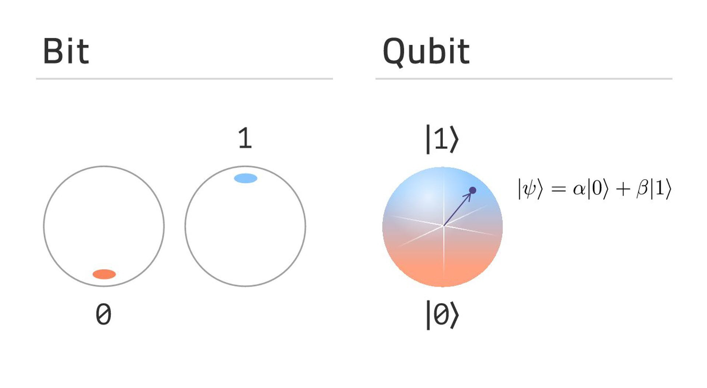
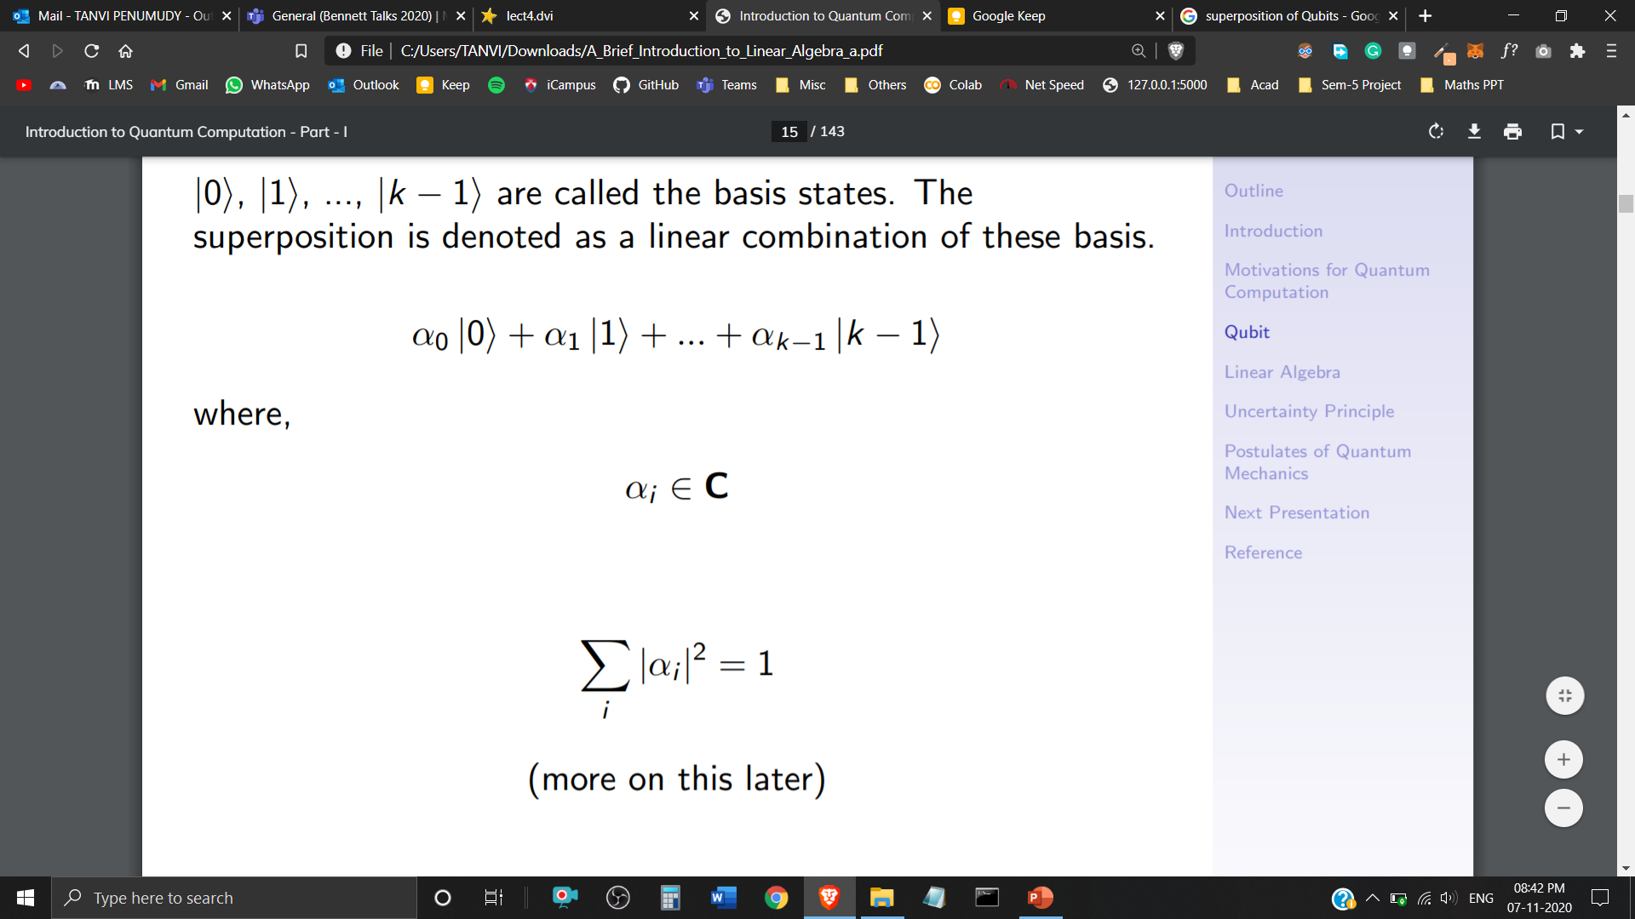
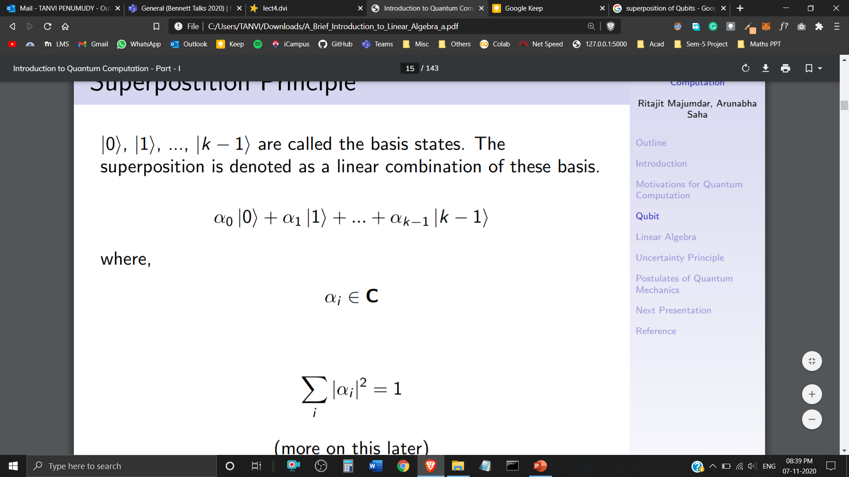
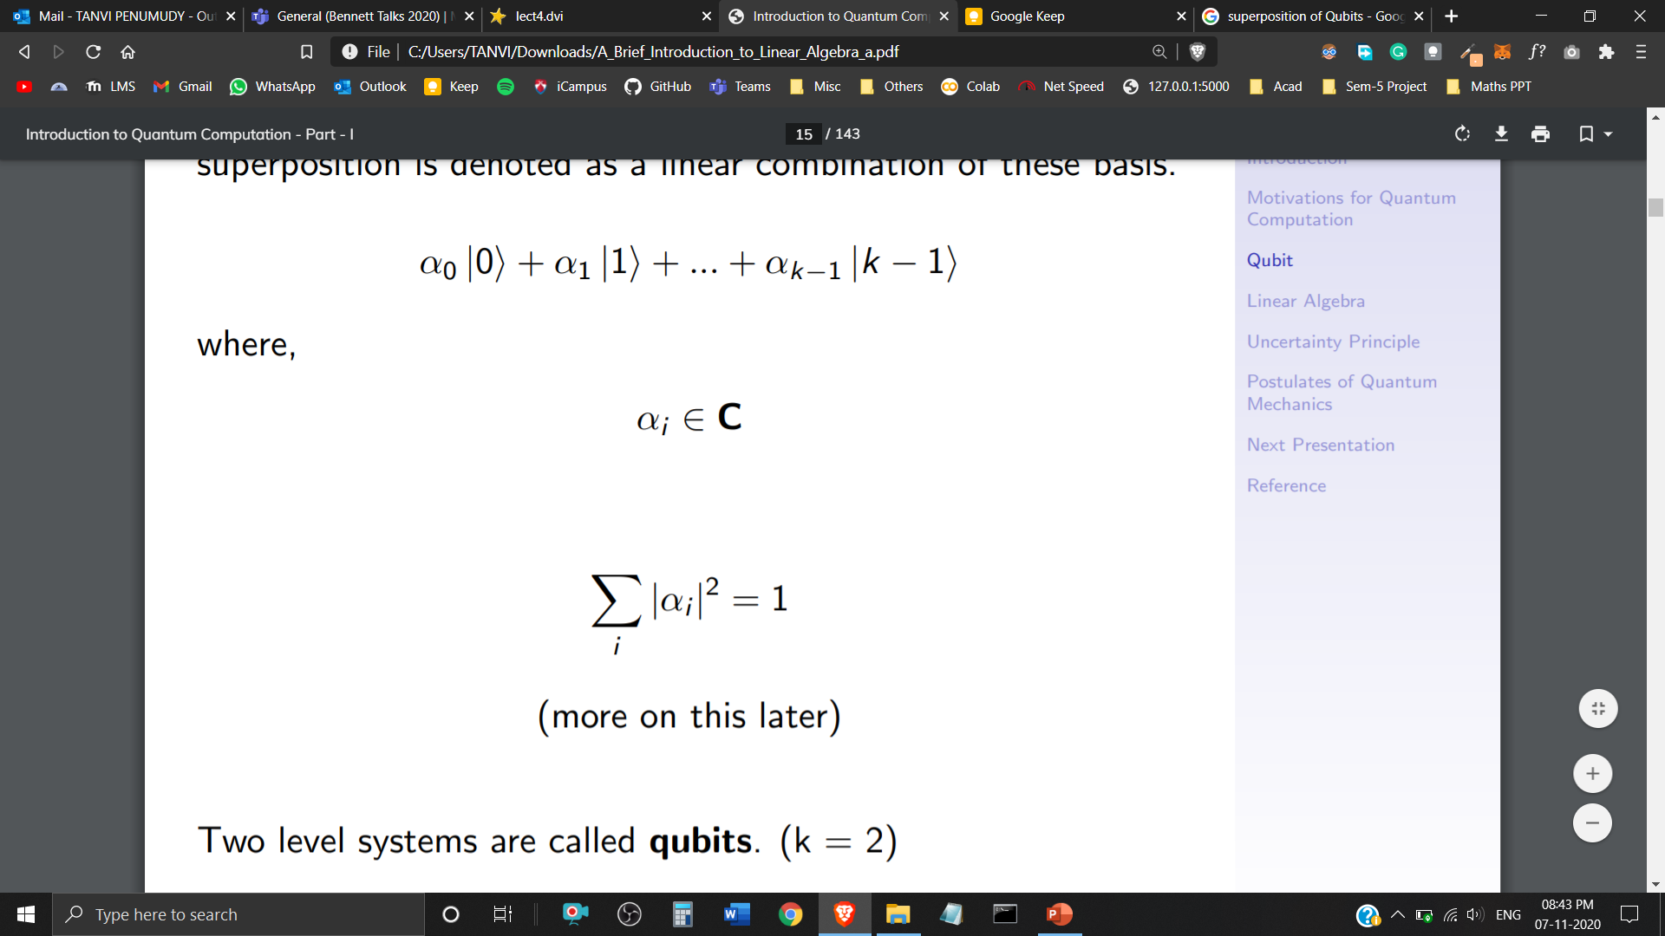

Superposition
In classical computation, bits are either represented with 0 or 1.
In Quantum Computation, these bits are replaced by a superposition of both 0 and 1.
If a quantum system can be in one of k states, it can also be in any linear superposition of those k states.
Two level systems are called Qubits (k=2)
are called the basis states, the superposition is denoted as a linear combination of these basis.
where, and

Slide 7
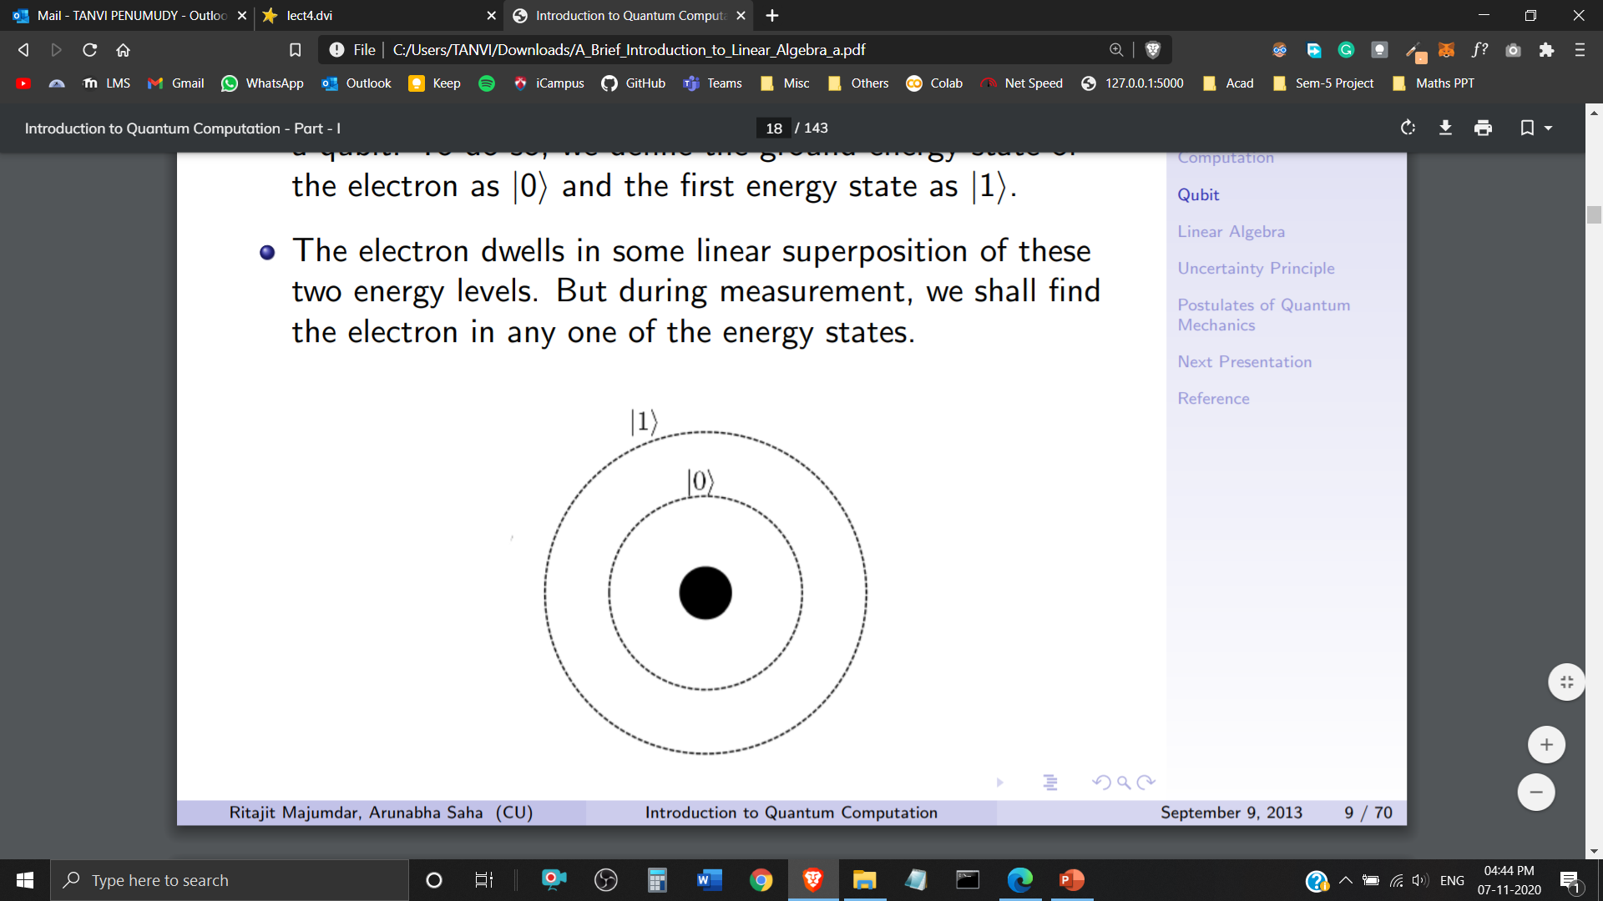
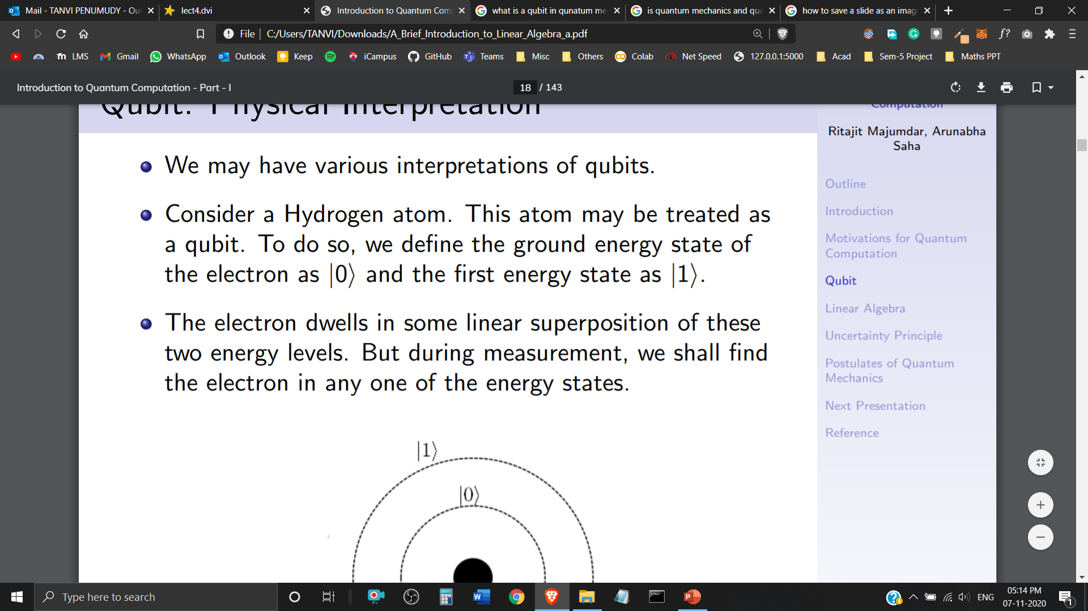
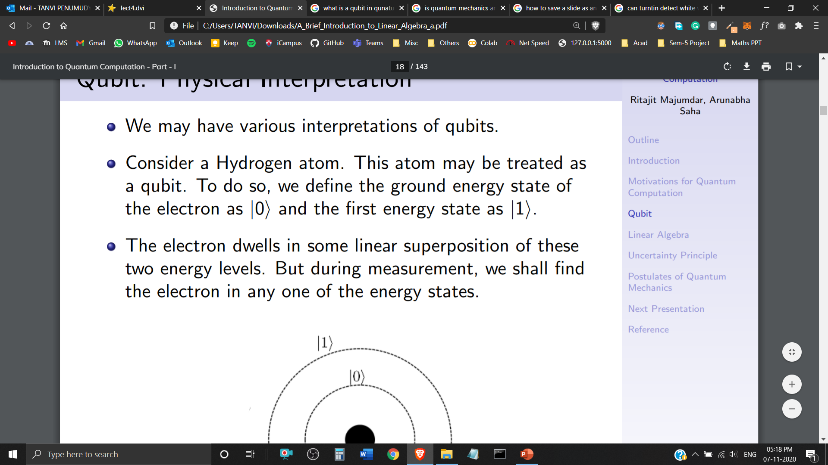
Qubits
In Quantum Computing, a Quantum Bit or a ‘Qubit’ is a building block or a basic unit of Quantum Information.
We have various physical interpretations of a Qubit in Quantum Mechanics.
Qubits are represented as and or their linear combination.
Qubits have been created in the laboratory using photons, ions and certain sorts of atomic nuclei.
A Hydrogen atom could be interpreted as a Qubit. An electron in its ground state, could be represented as and in its first energy state as .
The electron dwells in some linear superposition of these two energy levels. But during measurement, it can only be found in one of these energy states.
Hydrogen Atom

Slide 8
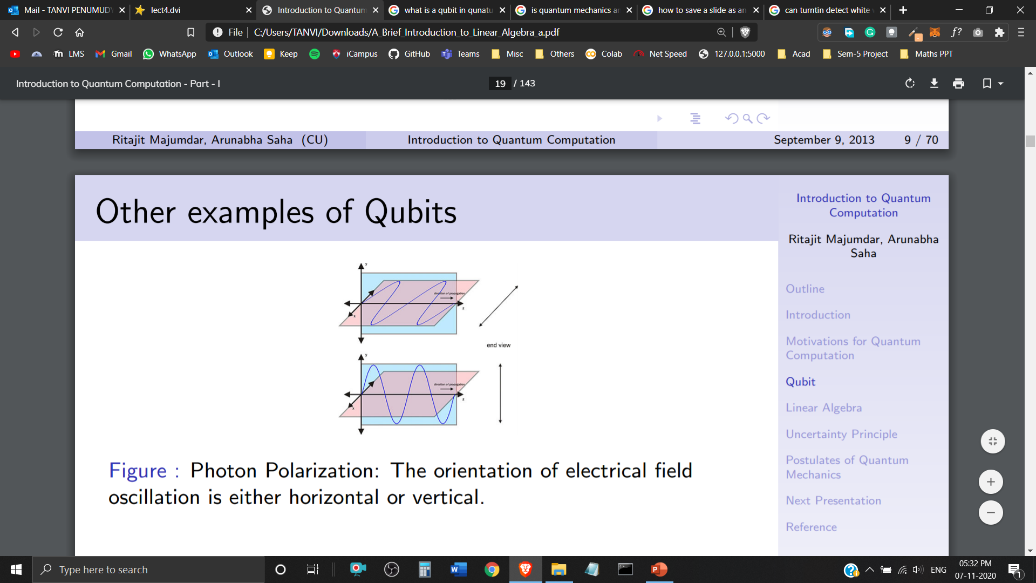
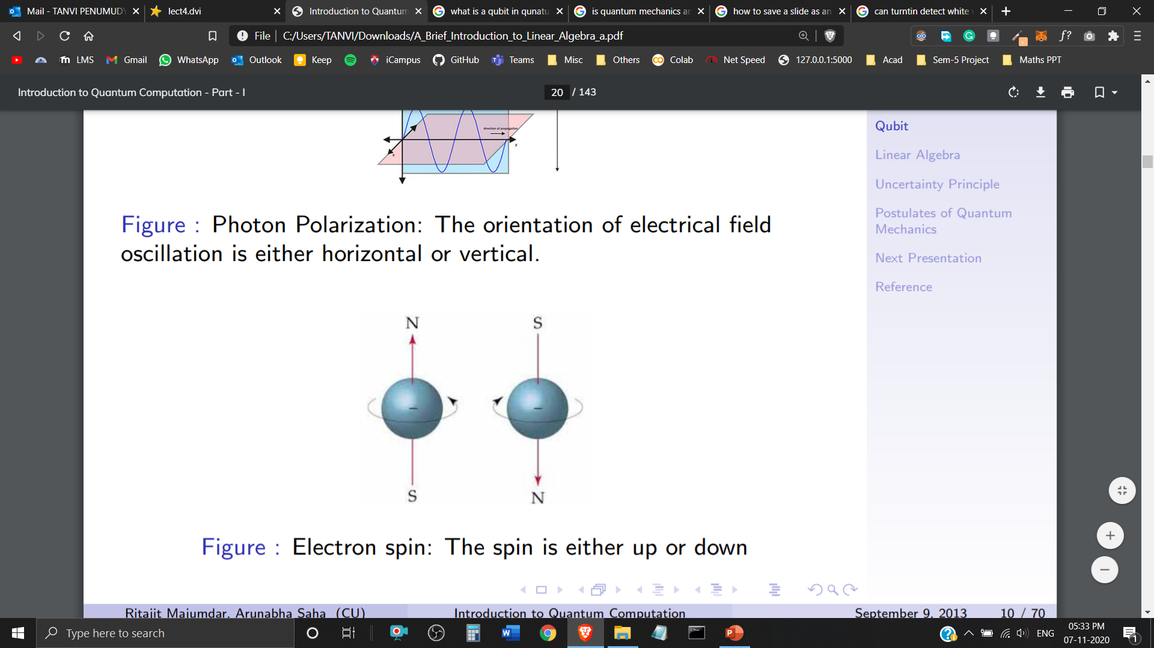
Physical Interpretation of Qubits
Photon Polarization: The orientation of electrical field oscillation is either horizontal or vertical.
Electron Spin: The electron spin is either up or down.

Slide 9
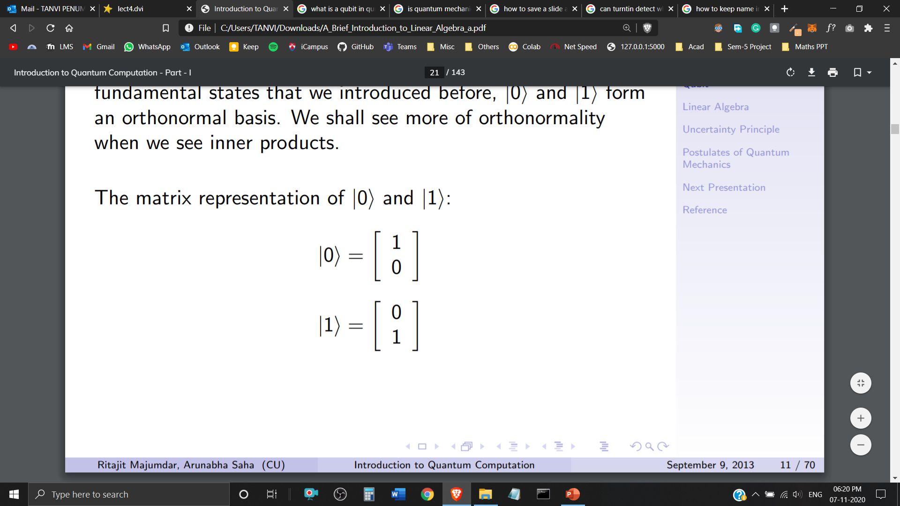
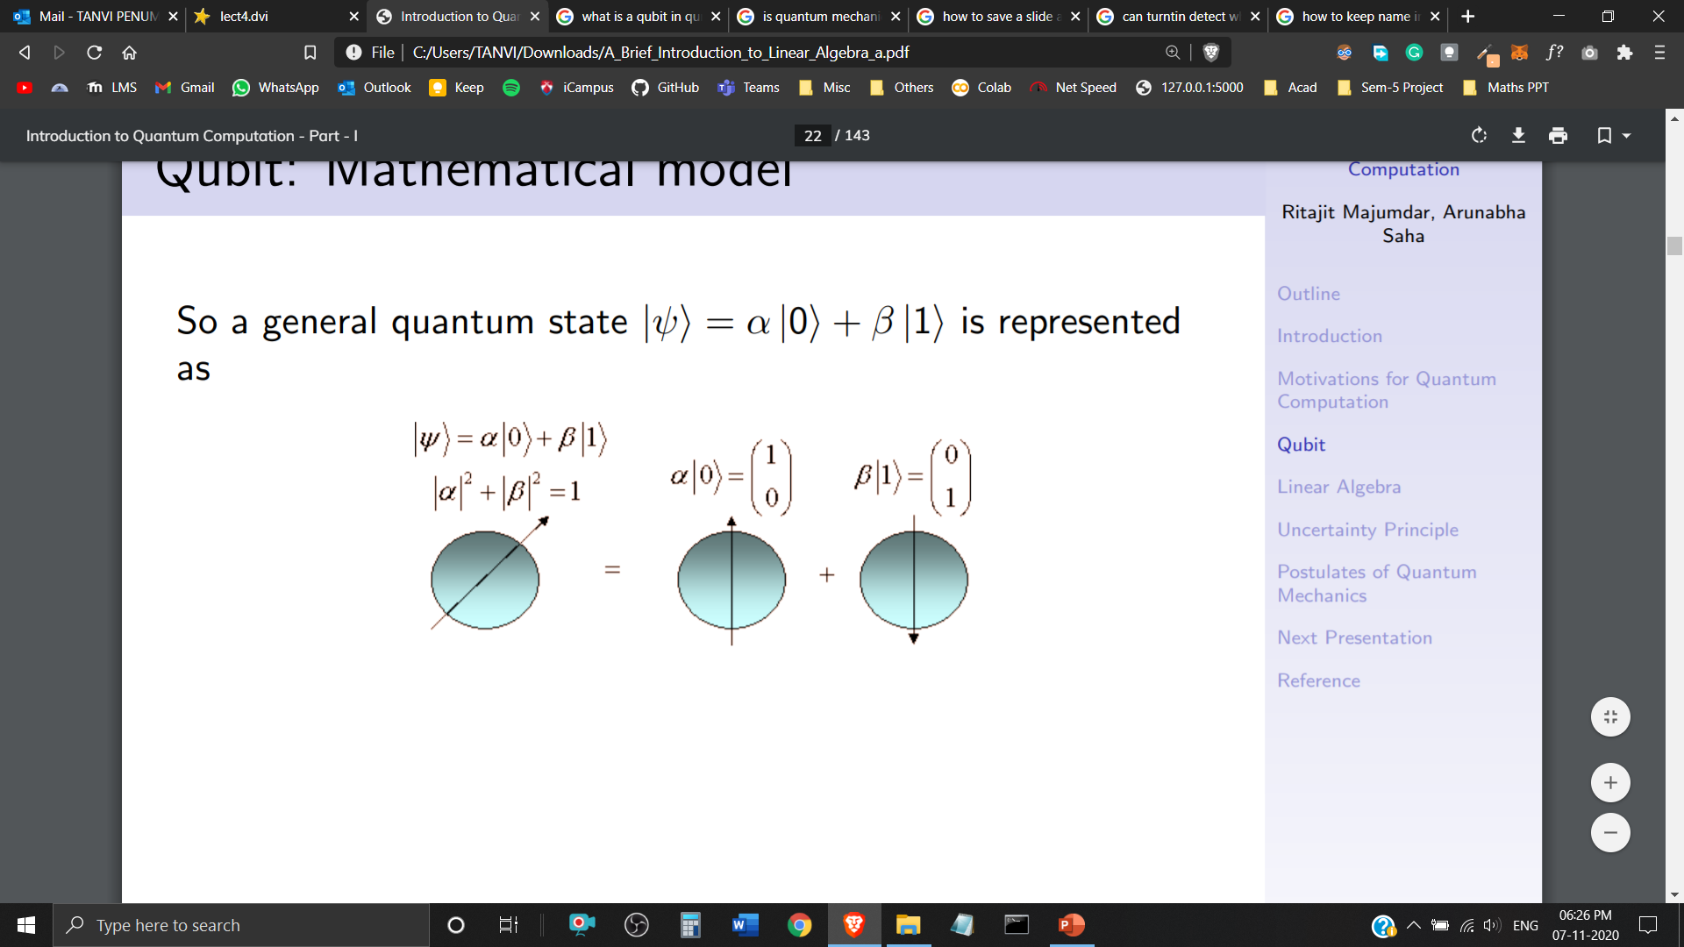
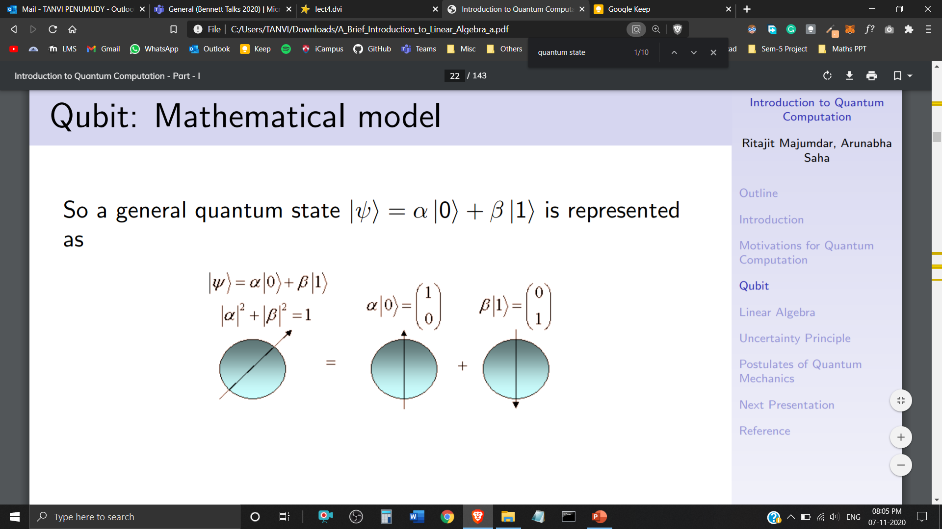
Representation of Qubits
Matrix Representation of and
A Qubit is Mathematically represented as a Quantum State of the form

Slide 10
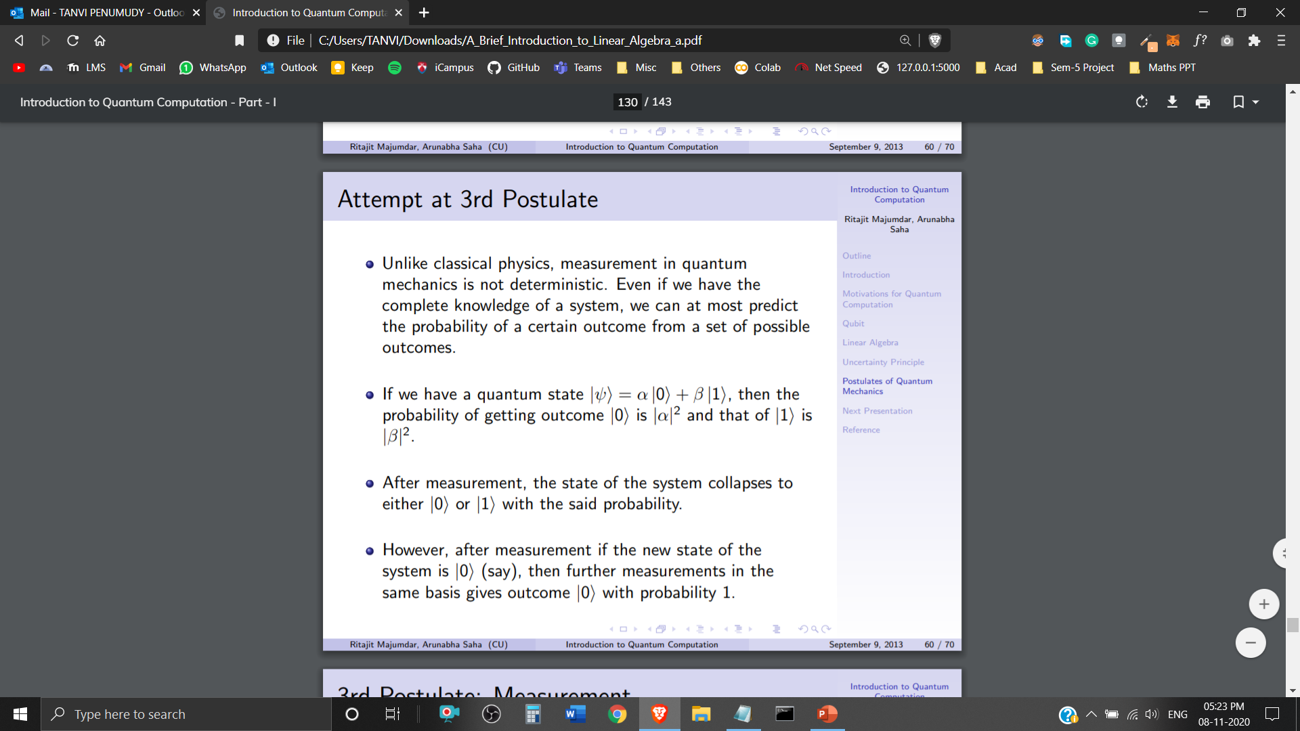
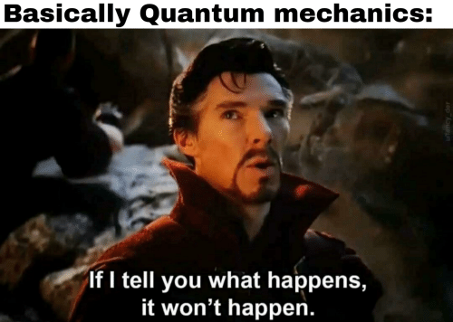
Non-Determinism
Attempt at 3rd Postulate of Quantum Mechanics
Unlike classical physics, measurement in quantum mechanics is not deterministic. Even if we have the complete knowledge of a system, we can at most predict the probability of a certain outcome from a set of possible outcomes.

Slide 11
Postulate 3
of Quantum Mechanics
The postulate states that a quantum system stays in a superposition when it is not observed.
When a measurement is done, it immediately collapses to one of its eigenstates.
Hence, we can never observe what the original superposition of the system was. We merely observe the state after it collapses.
This inherent ambiguity provides an excellent security in Quantum Cryptography.
*Eigenstate (physics) is a dynamic quantum mechanical state whose wave function is an eigenvector that corresponds to a physical quantity.

Slide 12
Imagine to have 500 qubits, then 2⁵⁰⁰ complex coefficients describe their state.
How to store this state?
2⁵⁰⁰ is larger than the number of atoms in the universe.
It is impossible in classical bits.
This is also why it is hard to simulate quantum systems on classical computers.
A quantum computer would be much more efficient than a classical computer at simulating quantum systems.
Superposition and Entanglement are what give quantum computers the ability to process so much more information so much faster.

Slide 13
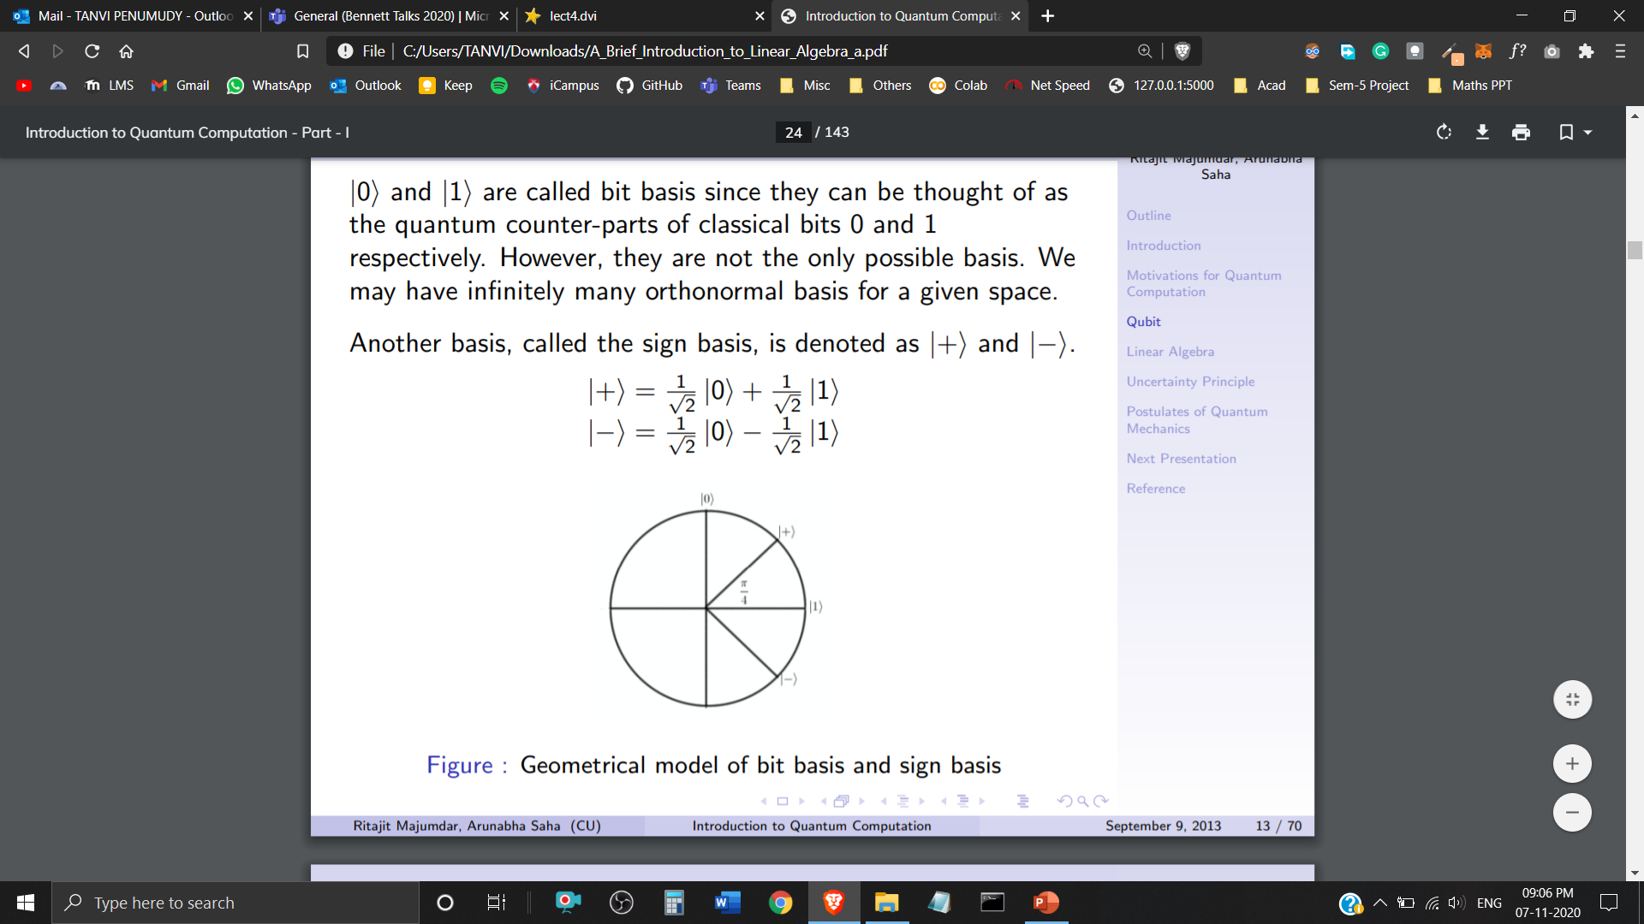
Sign Basis
and are called the bit basis. However, they aren’t the only possible basis.
We can have infinitely many orthonormal basis for a given space.
Another basis, called the sign basis is denoted as and
Geometrical Representation of Basis

Slide 14
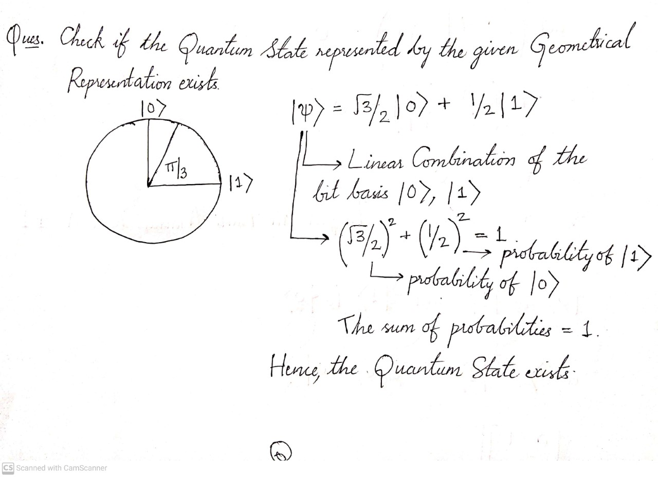

Slide 15
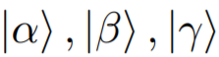
Vector Space in Quantum Computing
A Vector Space consists of Quantum States (Vectors) – together with a set of Scalars – a, b, c (belonging to Complex Numbers). It is closed under two operations:
Vector Addition
Scalar Multiplication

Slide 16
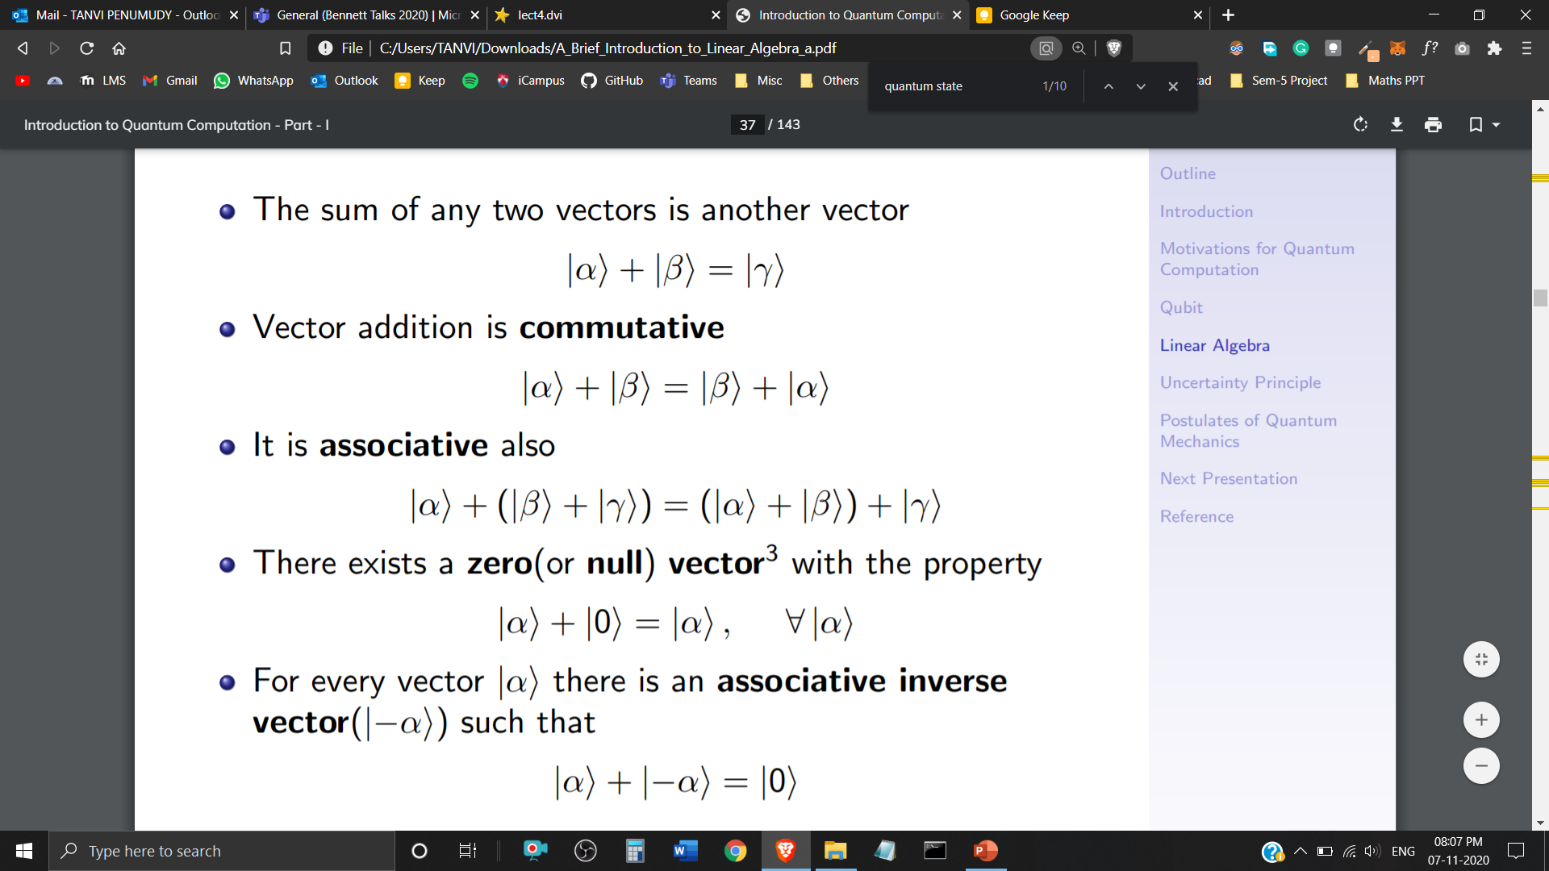
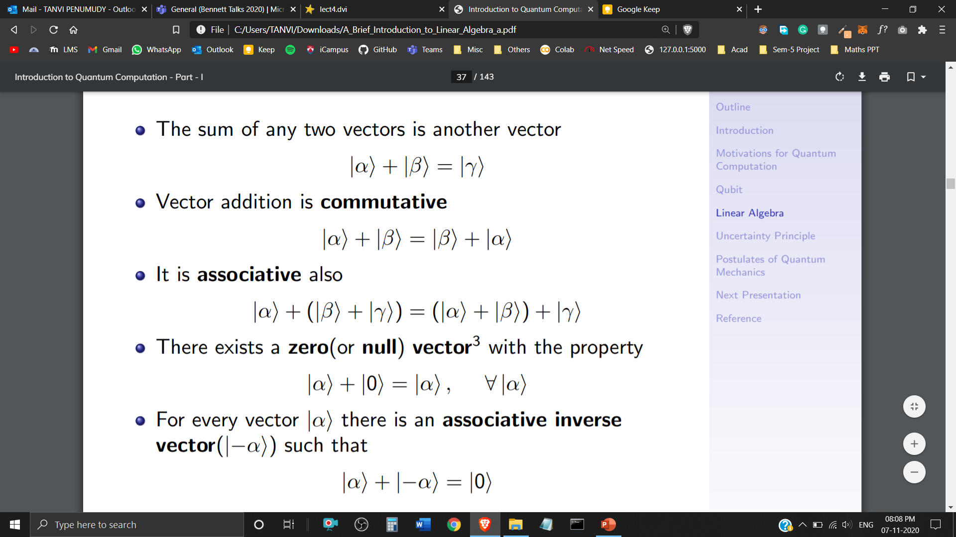
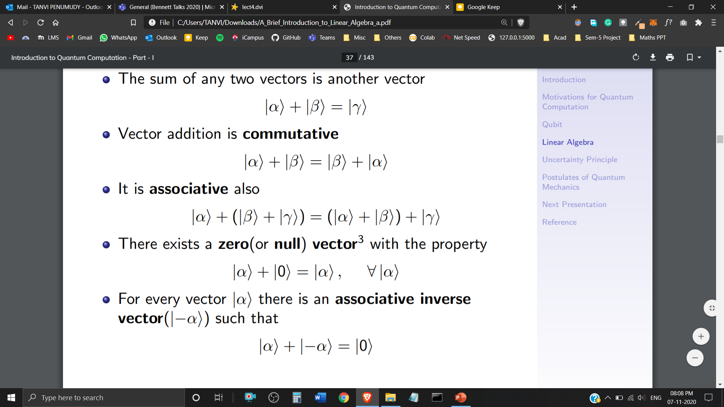
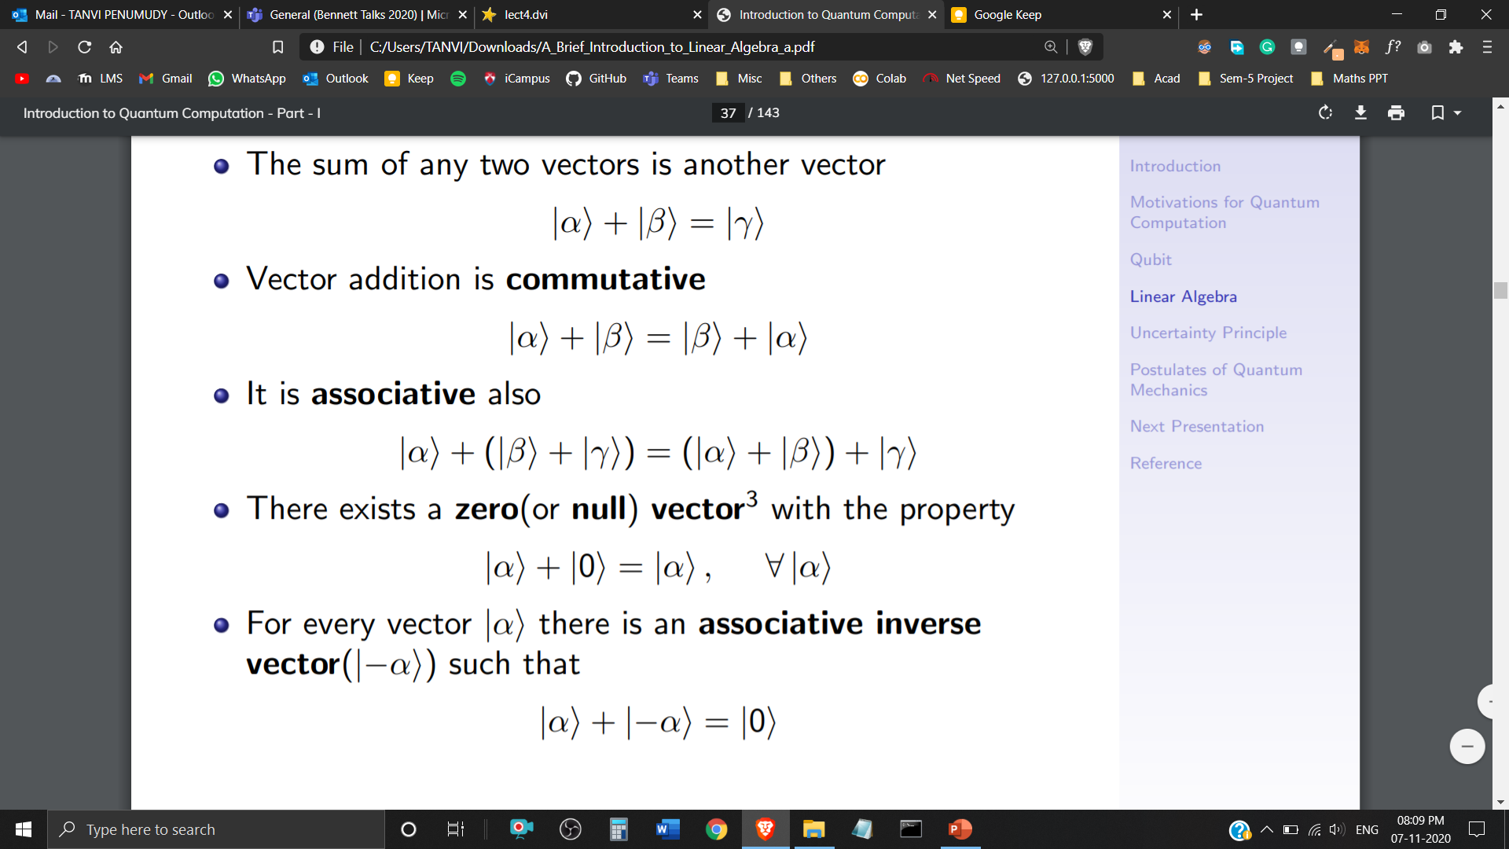

Vector Addition
Closure Property
Commutative Property
Associative Property
Additive Identity
Additive Inverse

Slide 17
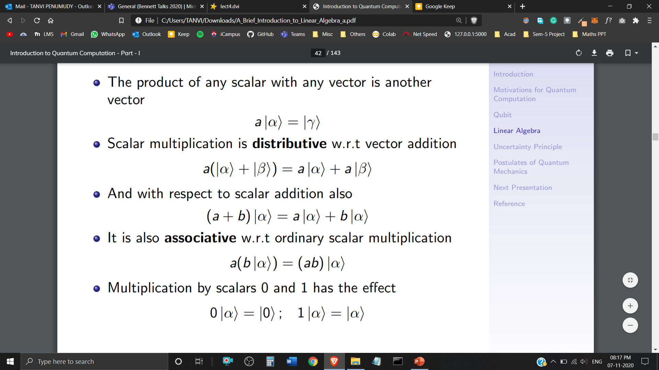



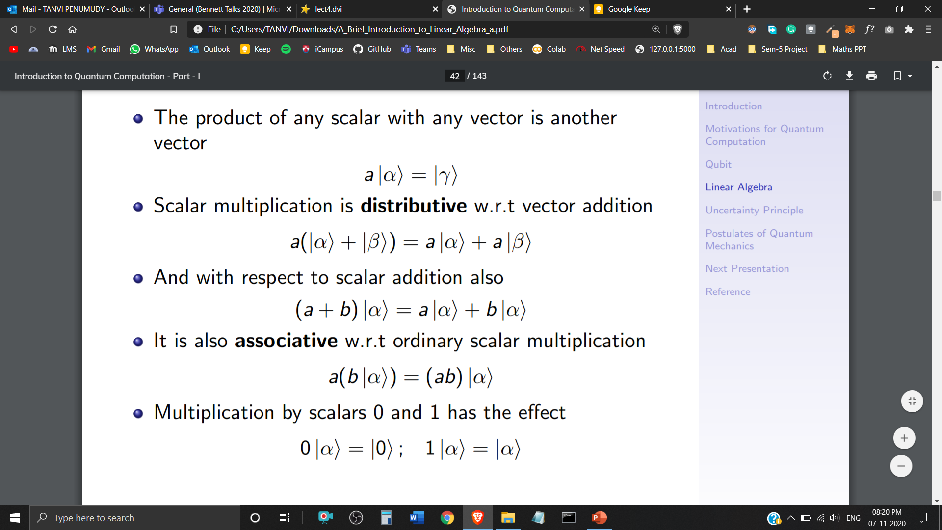
Scalar Multiplication
Closure Property
Distributive w.r.t Vector Addition
Distributive w.r.t Scalar Addition
Associative w.r.t Ordinary Scalar Multiplication
Multiplication with Scalars 0 and 1

Slide 18
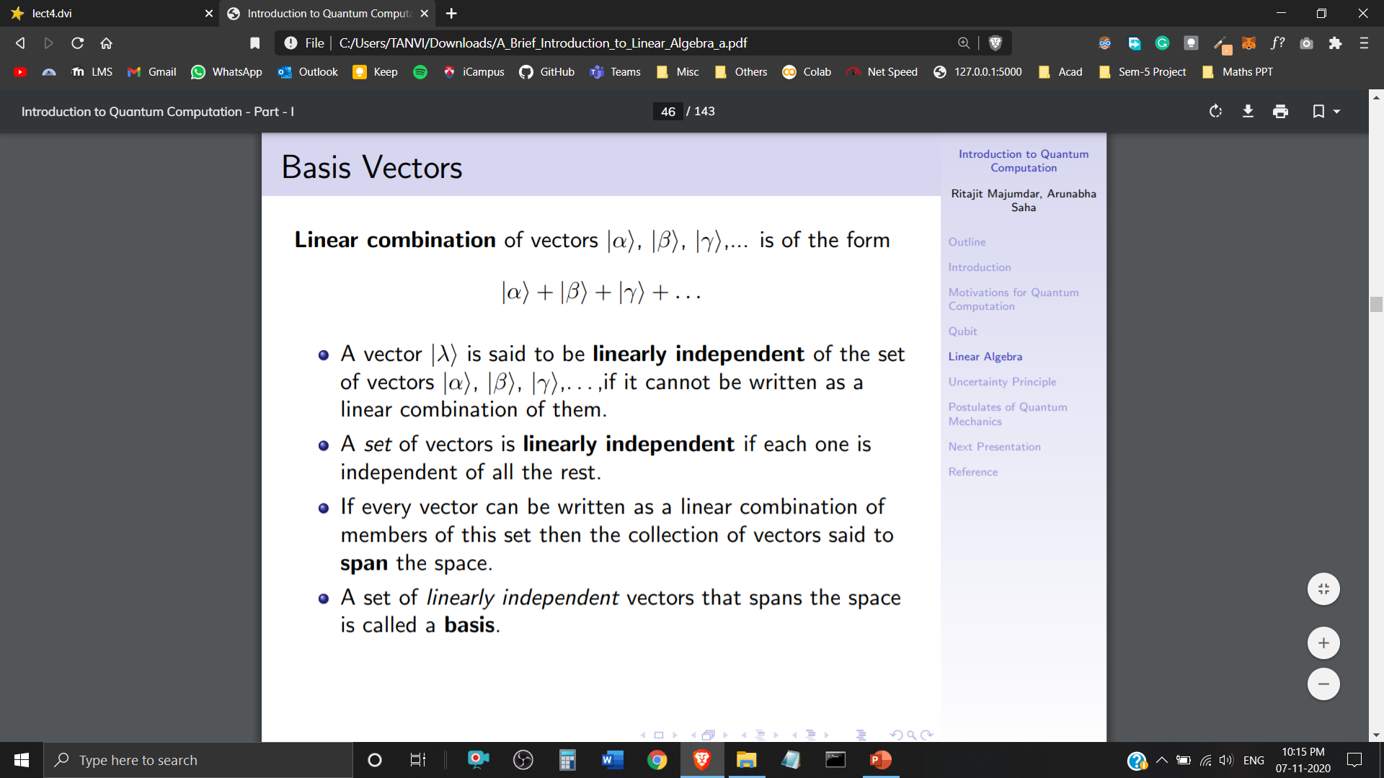

Basis
Linear Combination of Quantum States is in the form of
A Quantum State is said to be linearly independent of the set of Quantum States , if it cannot be written as a Linear Combination of them.
If every Quantum State can be written as a Linear Combination of this set, then the collection of Quantum States said to Span the space.
A set of Linearly Independent Quantum States that span the space is called a Basis.

Slide 19
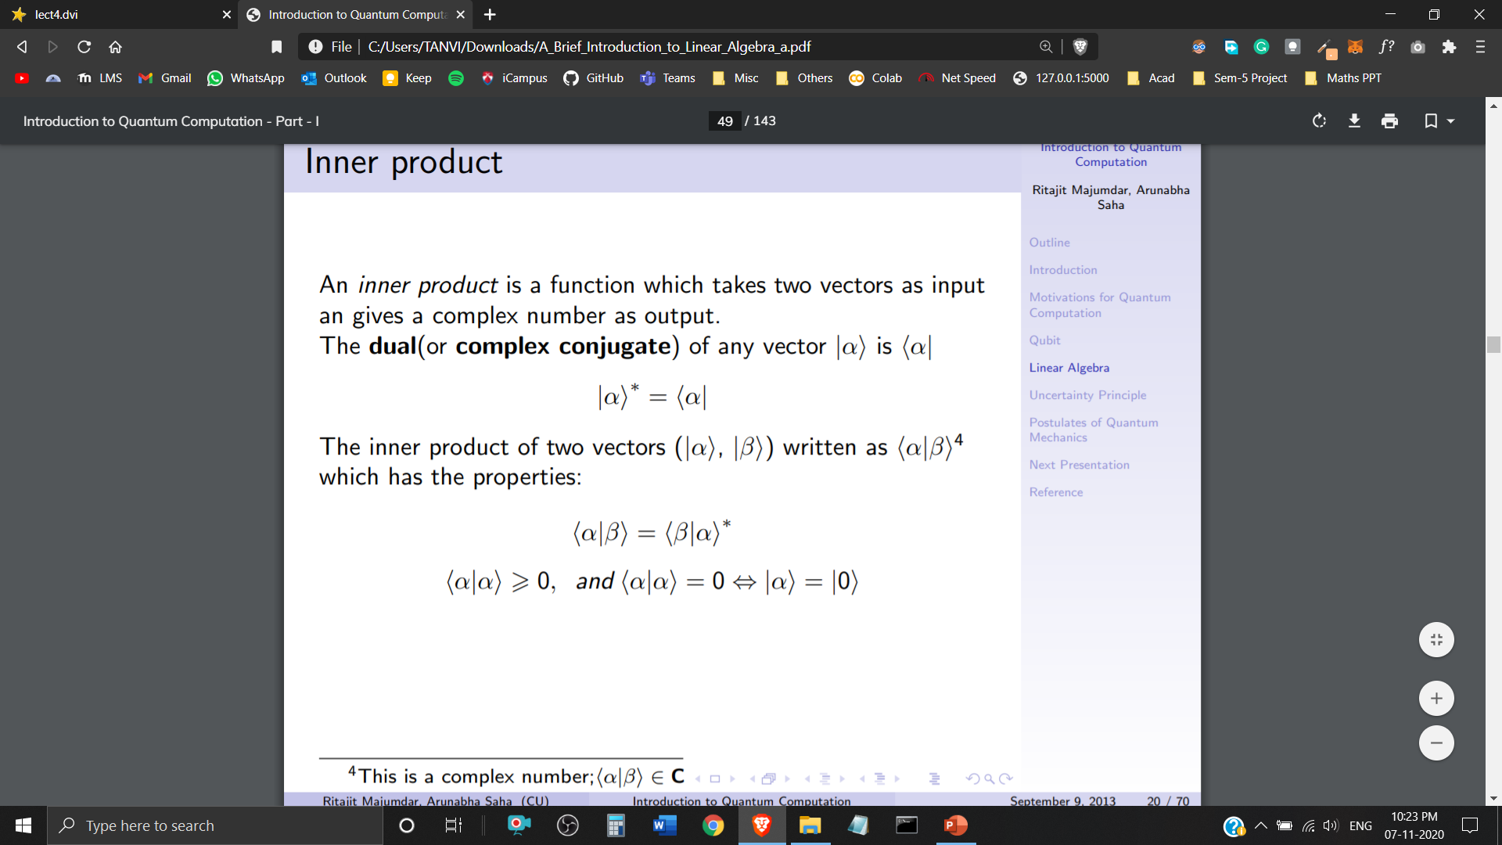
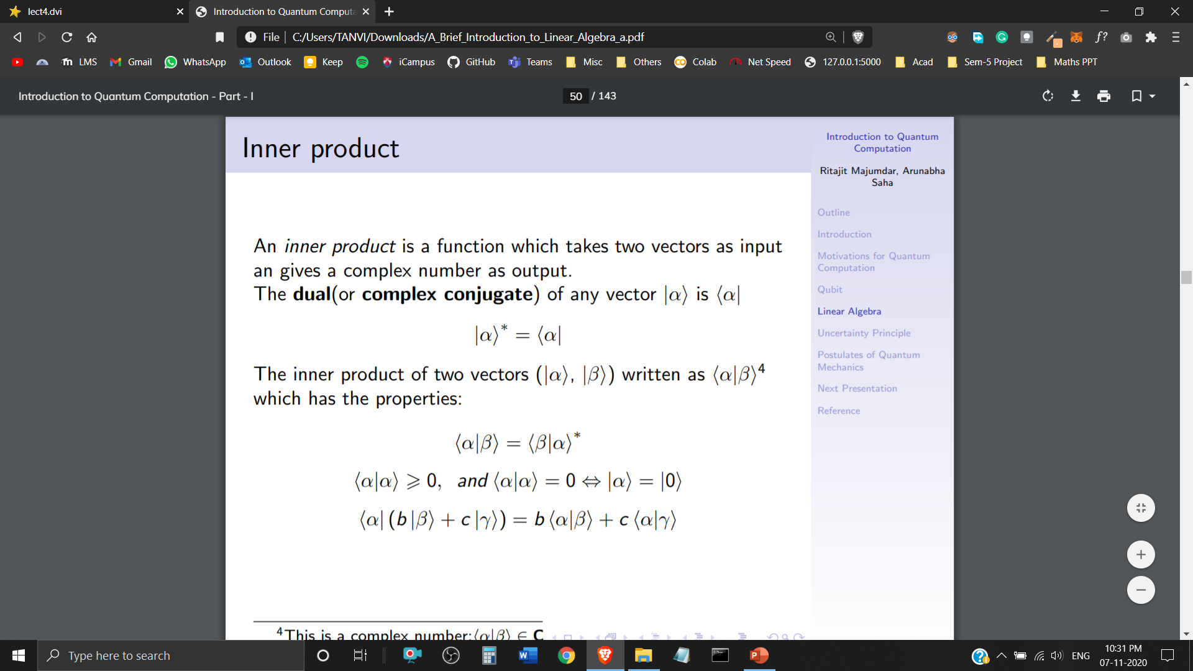

Inner Product
An inner product is a function which takes two Quantum States as input and gives a Complex Number as output.
The Dual (or Complex Conjugate) of any Quantum State (ket notation – column vector) is (bra notation – row vector)
The inner product of two Quantum States is written as

Slide 20
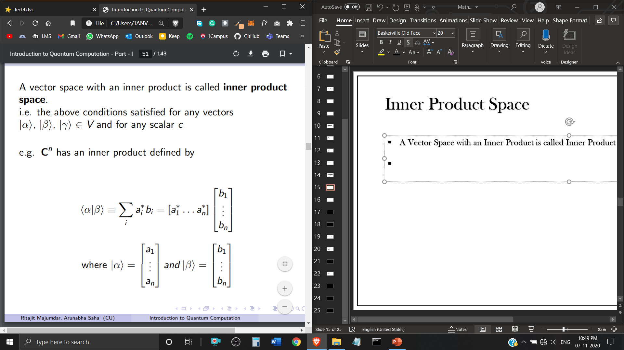
Inner Product Space
A Vector Space with an Inner Product is called Inner Product Space.
has an inner product defined by
where,

Slide 21
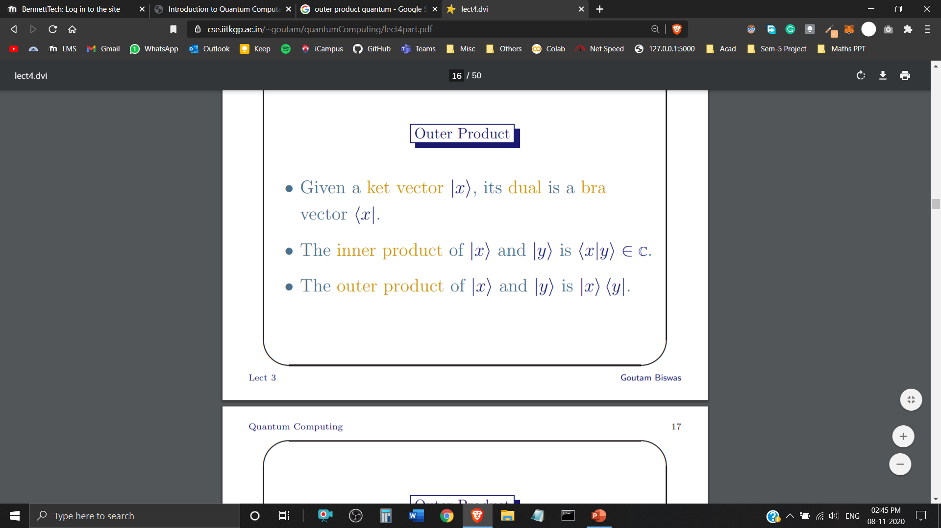
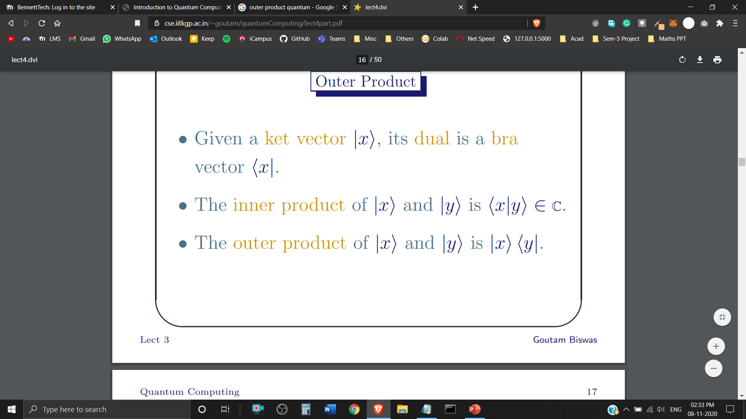
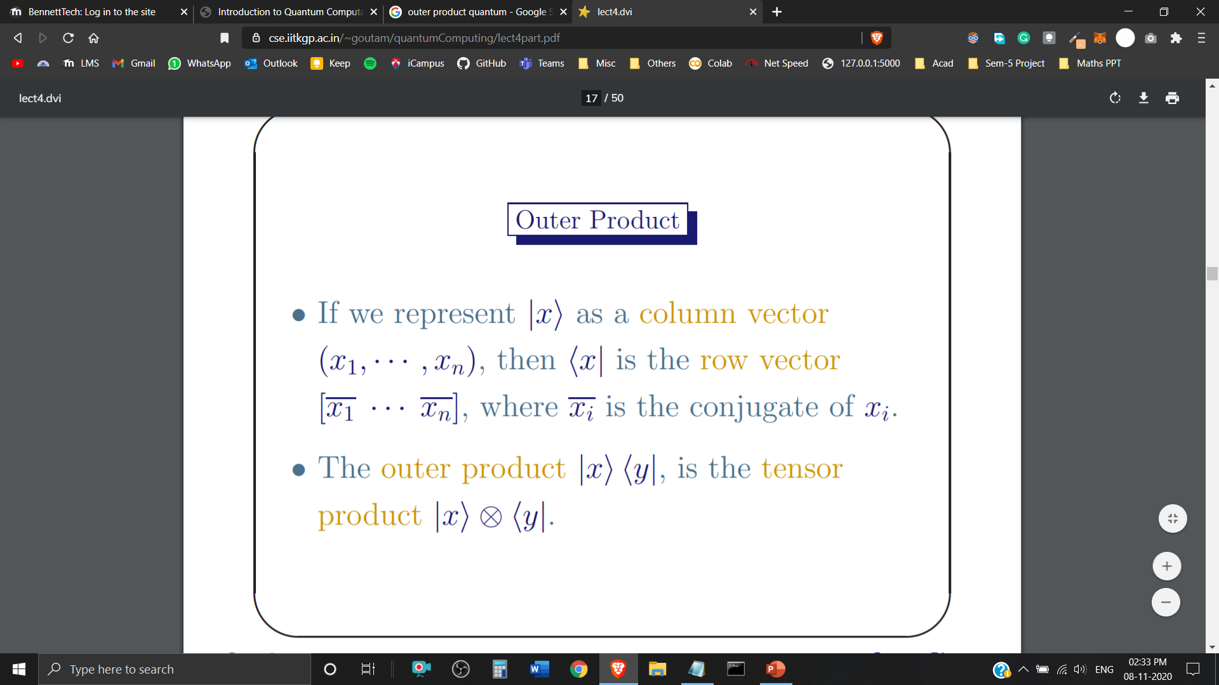
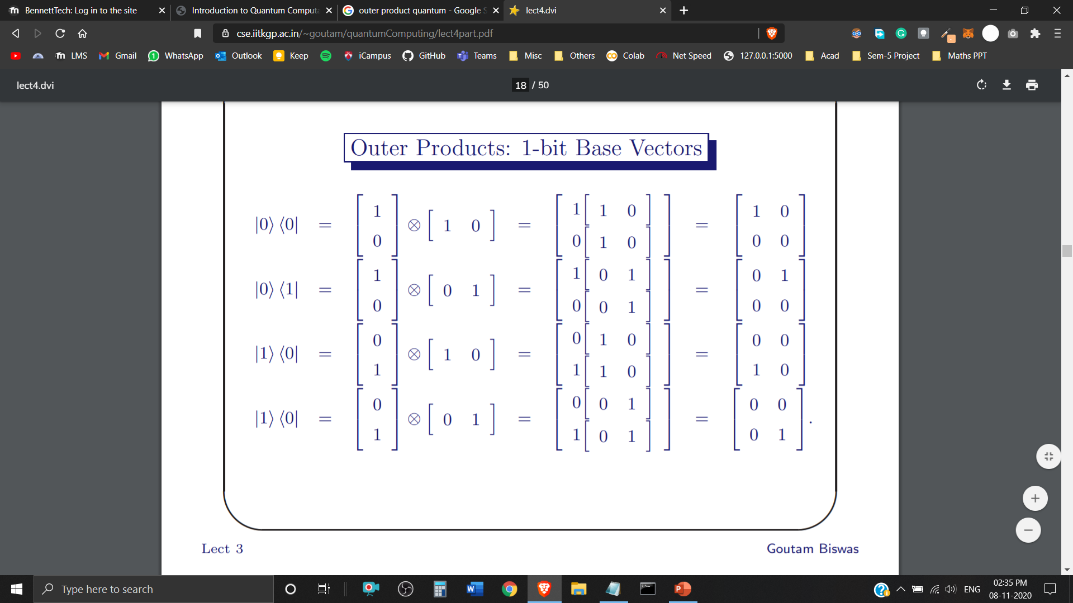
Outer Product

Slide 22
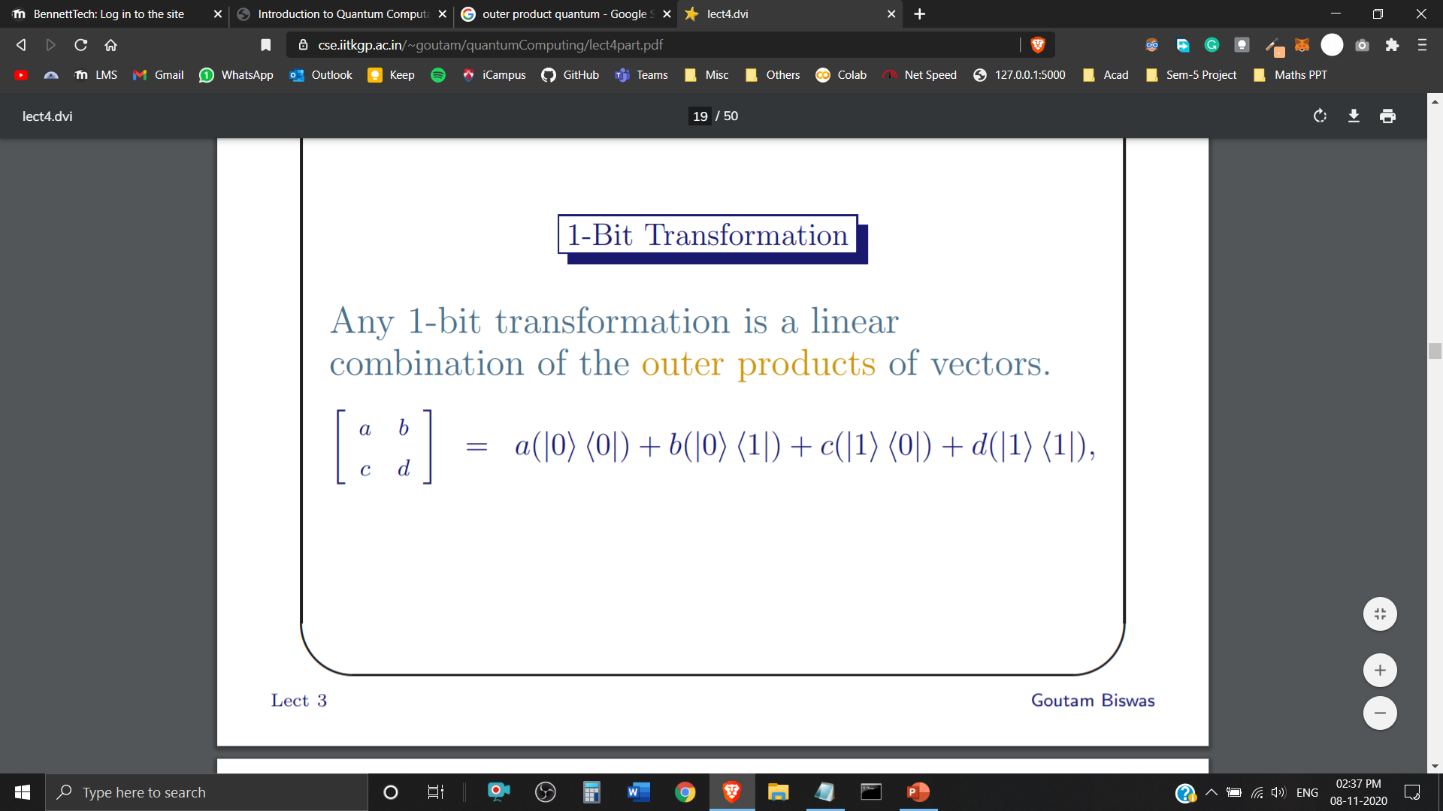
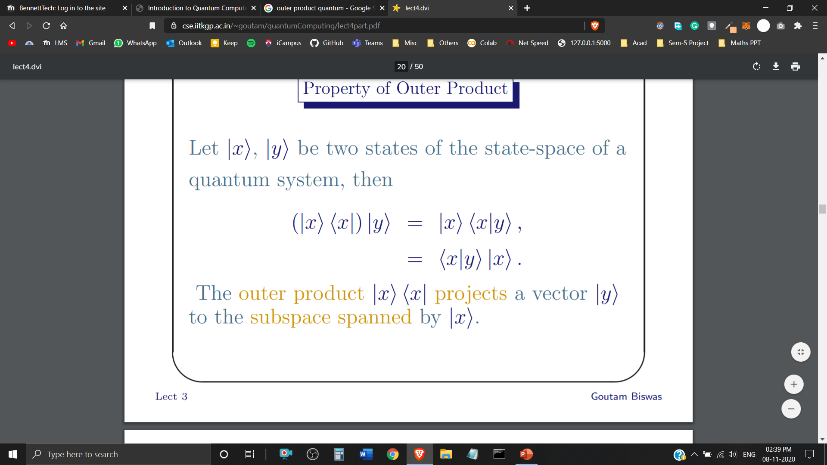
Outer Product
1-Bit Transformation (linear combination of the outer products of vectors)
Property of Outer Product

Slide 23
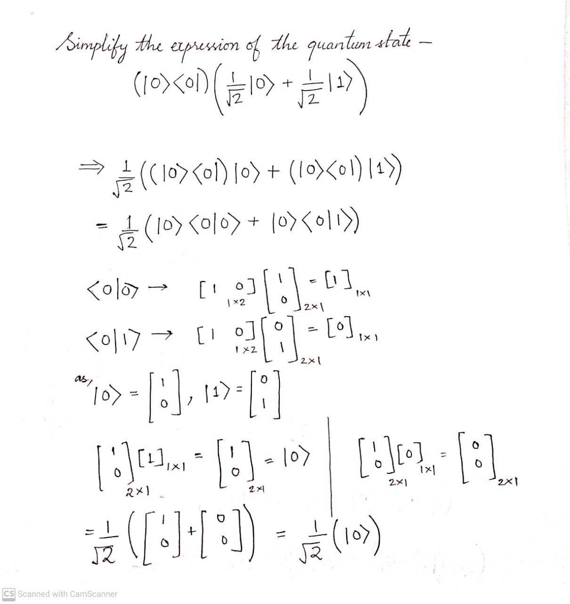
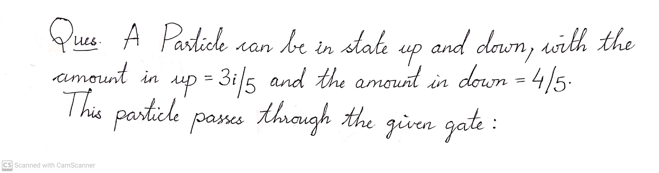
Optimization of Quantum State Expressions plays a crucial role in Quantum Computation and Quantum Information Processing.

Slide 24
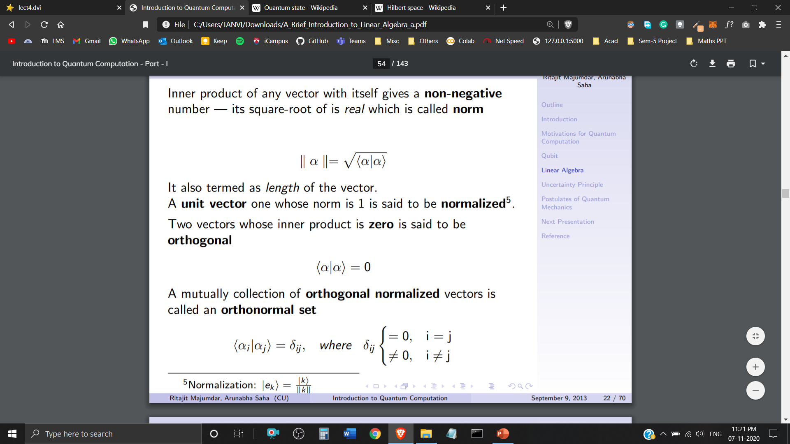
Orthonormal Set
Inner product of any Quantum State with itself gives a non-negative number – its square root of is real which is called norm. (Also termed as Vector Length)
A Quantum State with Norm 1 (Unit Vector) is said to be Normalized.
Two Quantum States with Inner Product zero are said to be Orthogonal.
A Mutual Collection of Orthogonal Normalized Quantum States is called an Orthonormal Set.

Slide 25
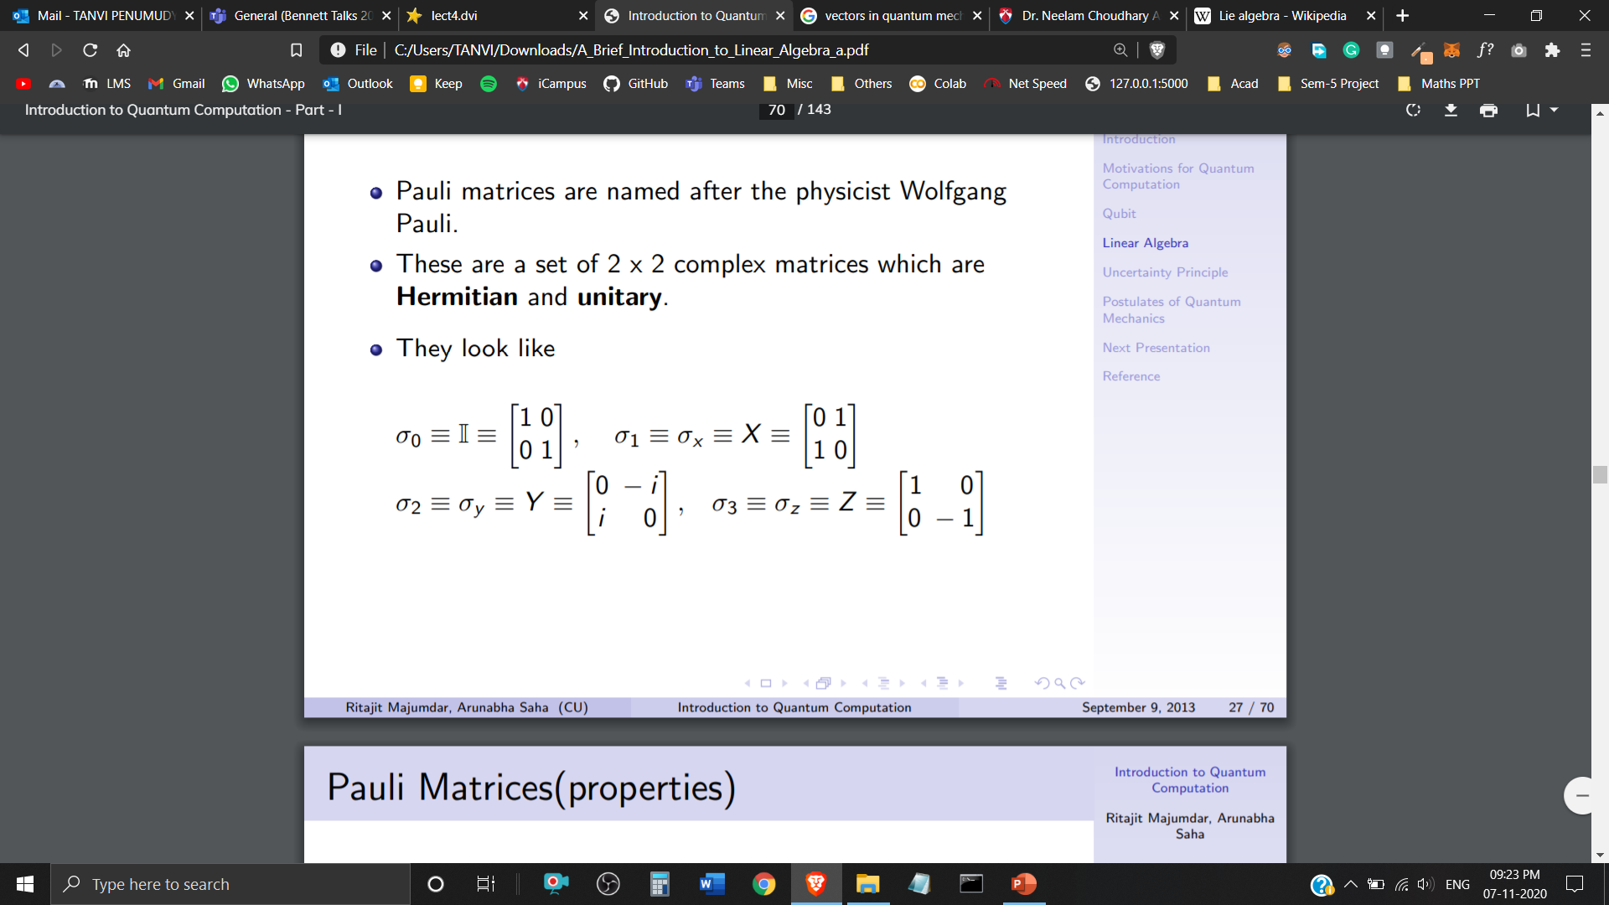
Pauli Matrices
Pauli Matrices are named after the physicist Wolfgang Pauli.
These are a set of 2 x 2 complex matrices which are Hermitian and Unitary.

Slide 26
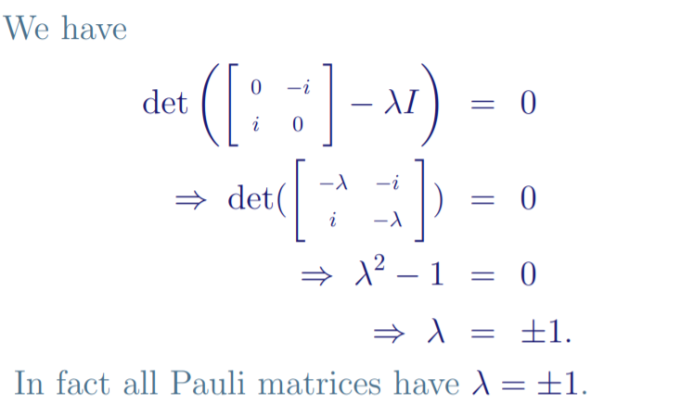
Eigenvalues of Y

Slide 27
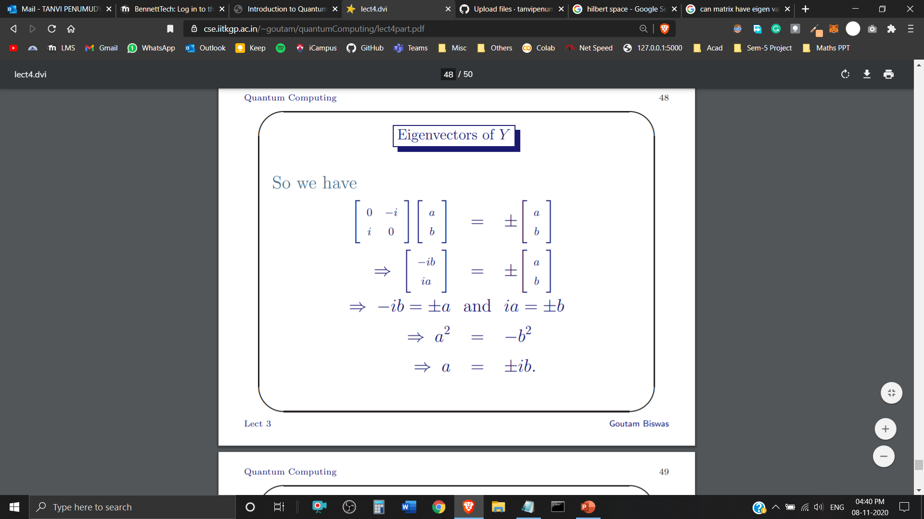
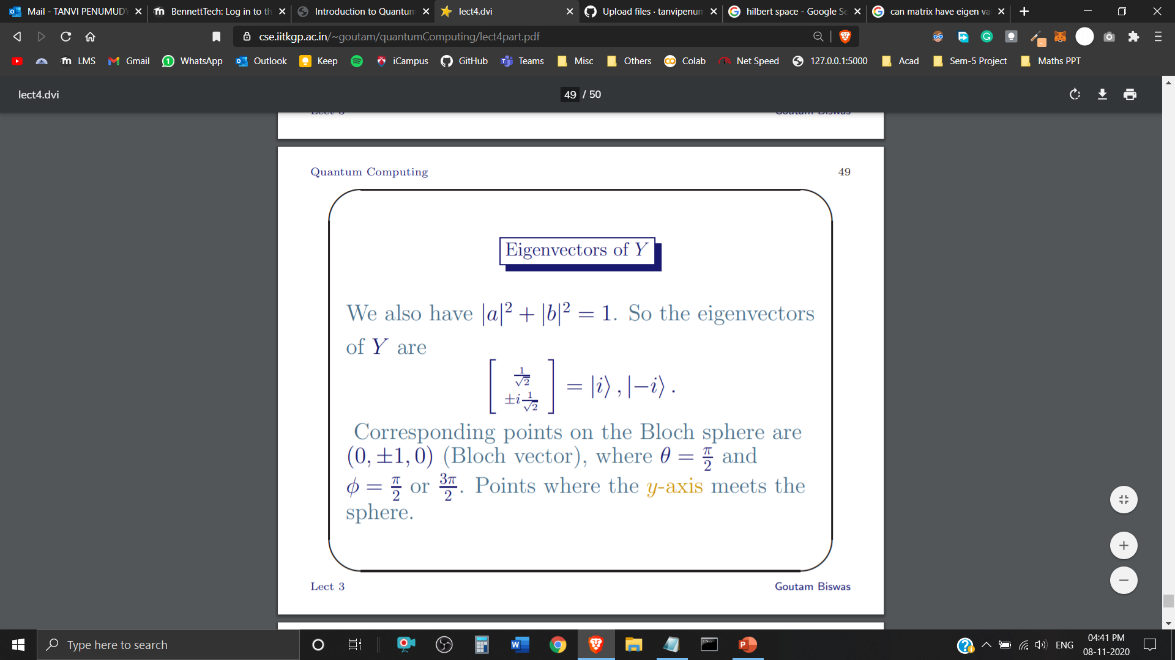
Eigenvectors of Y
Similarly, Eigenvectors can be computed for the remaining Pauli Matrices – X, Z

Slide 28
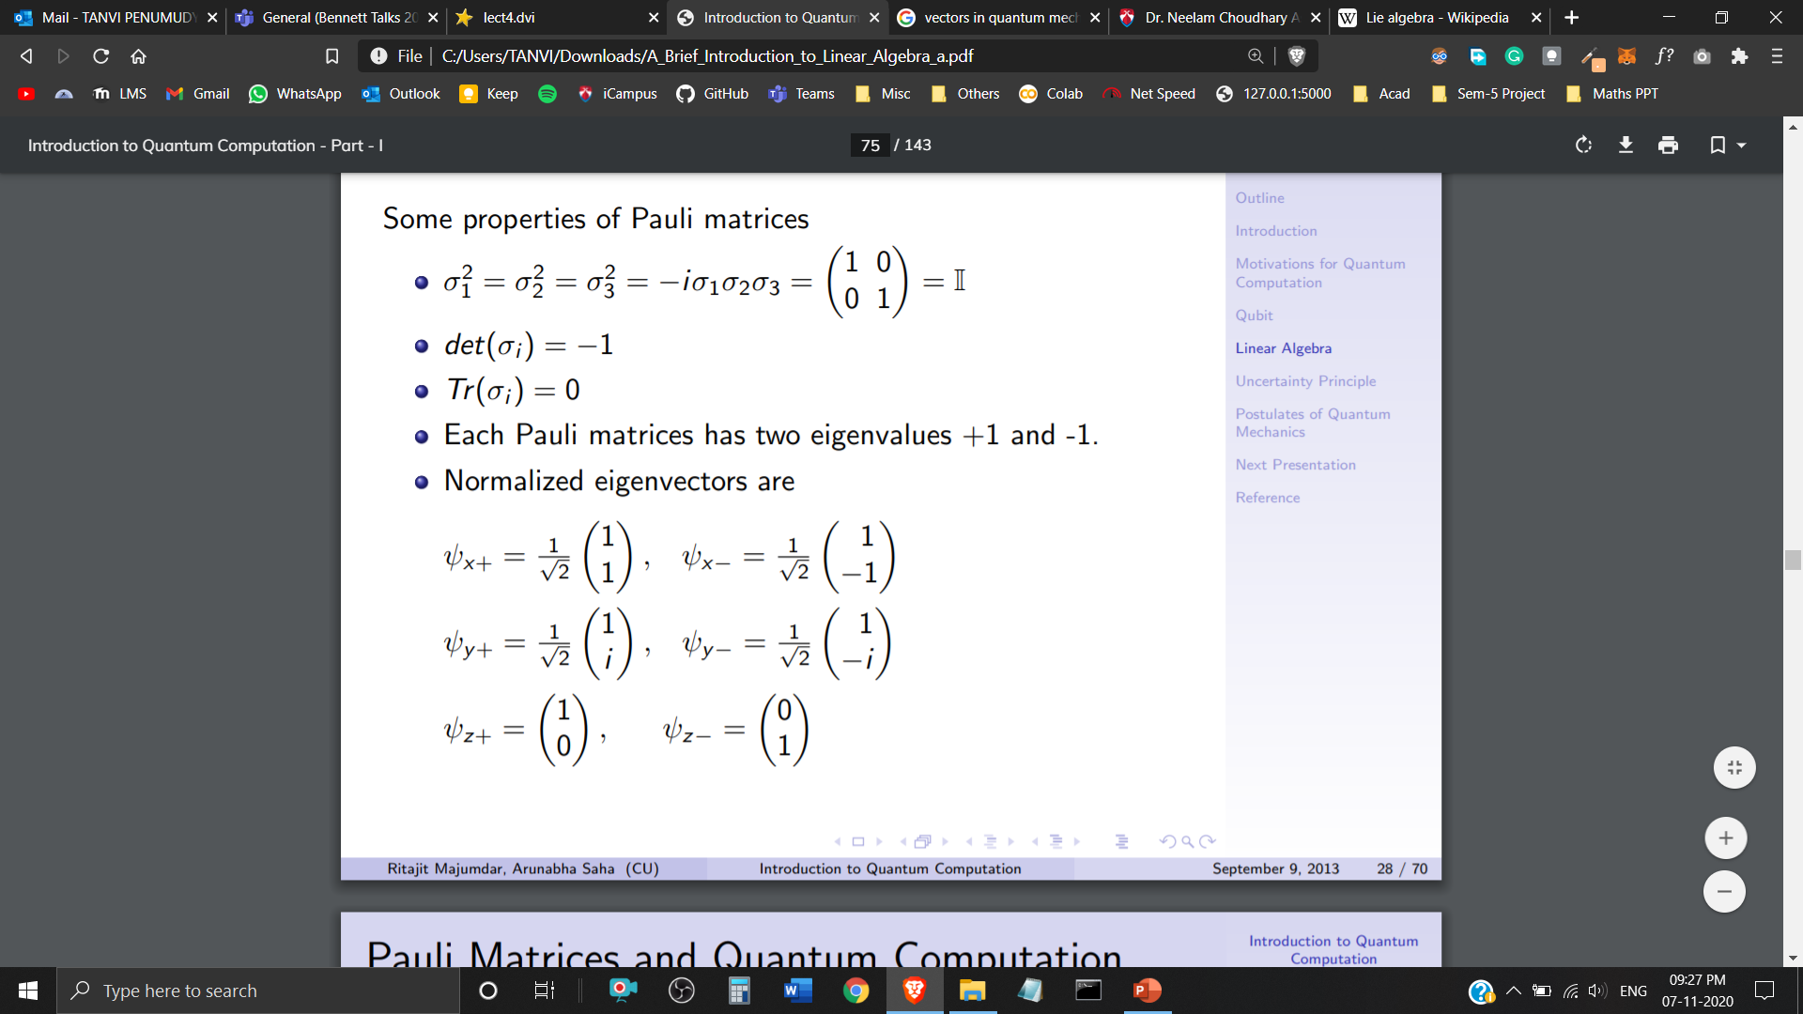
Properties of Pauli Matrices
Each Pauli Matrix has eigenvalues +1 and -1
Normalised Eigenvectors are

Slide 29
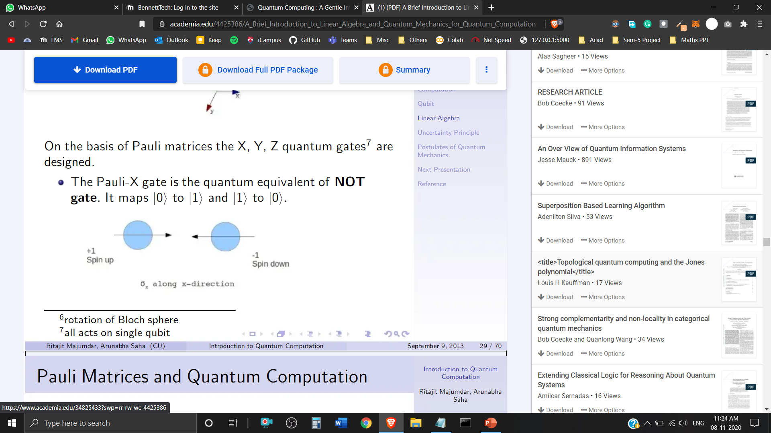
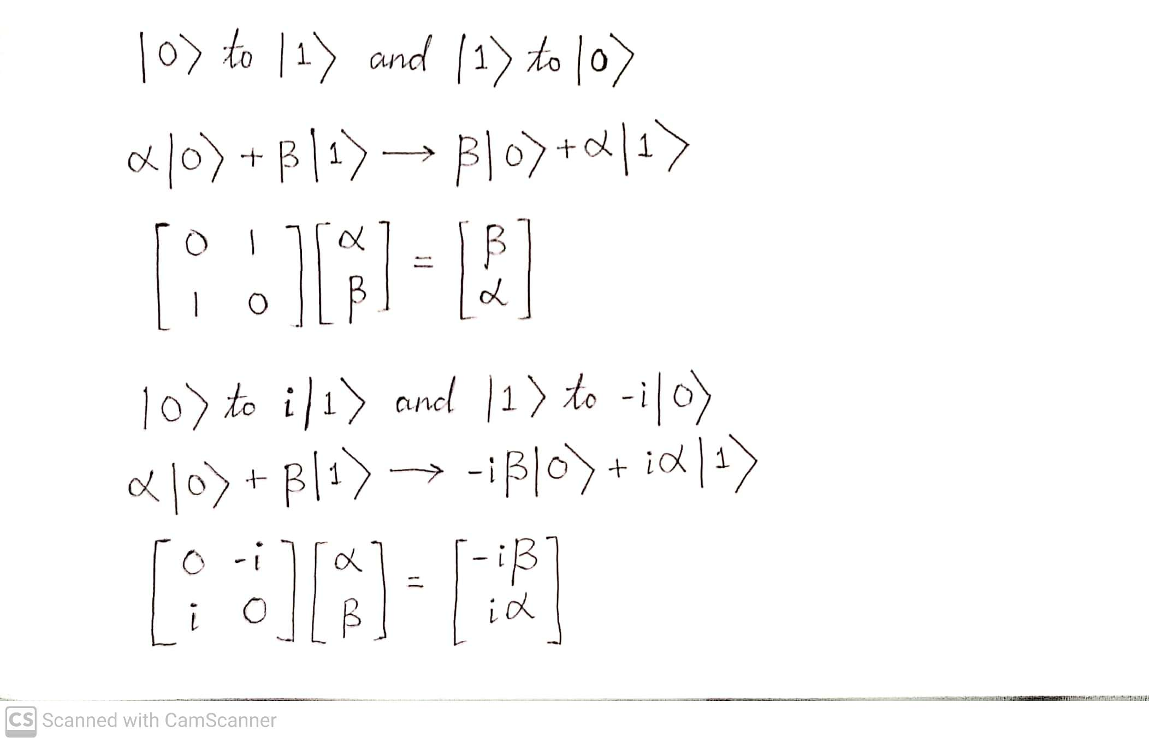
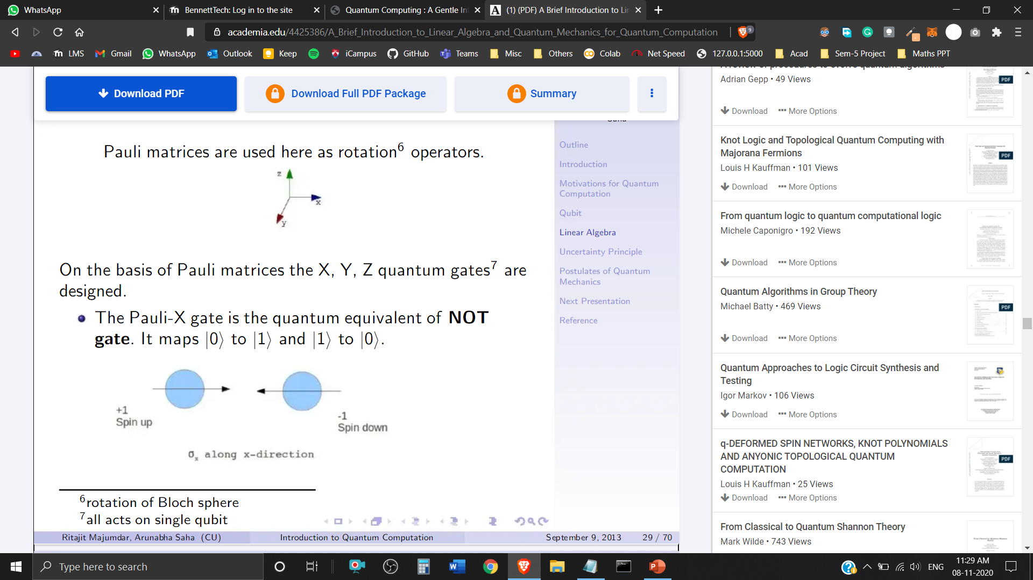
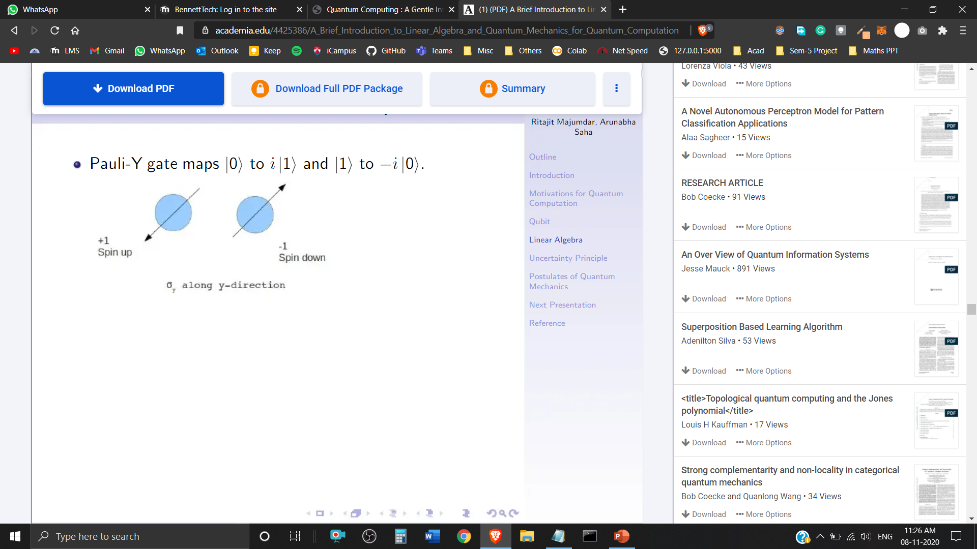
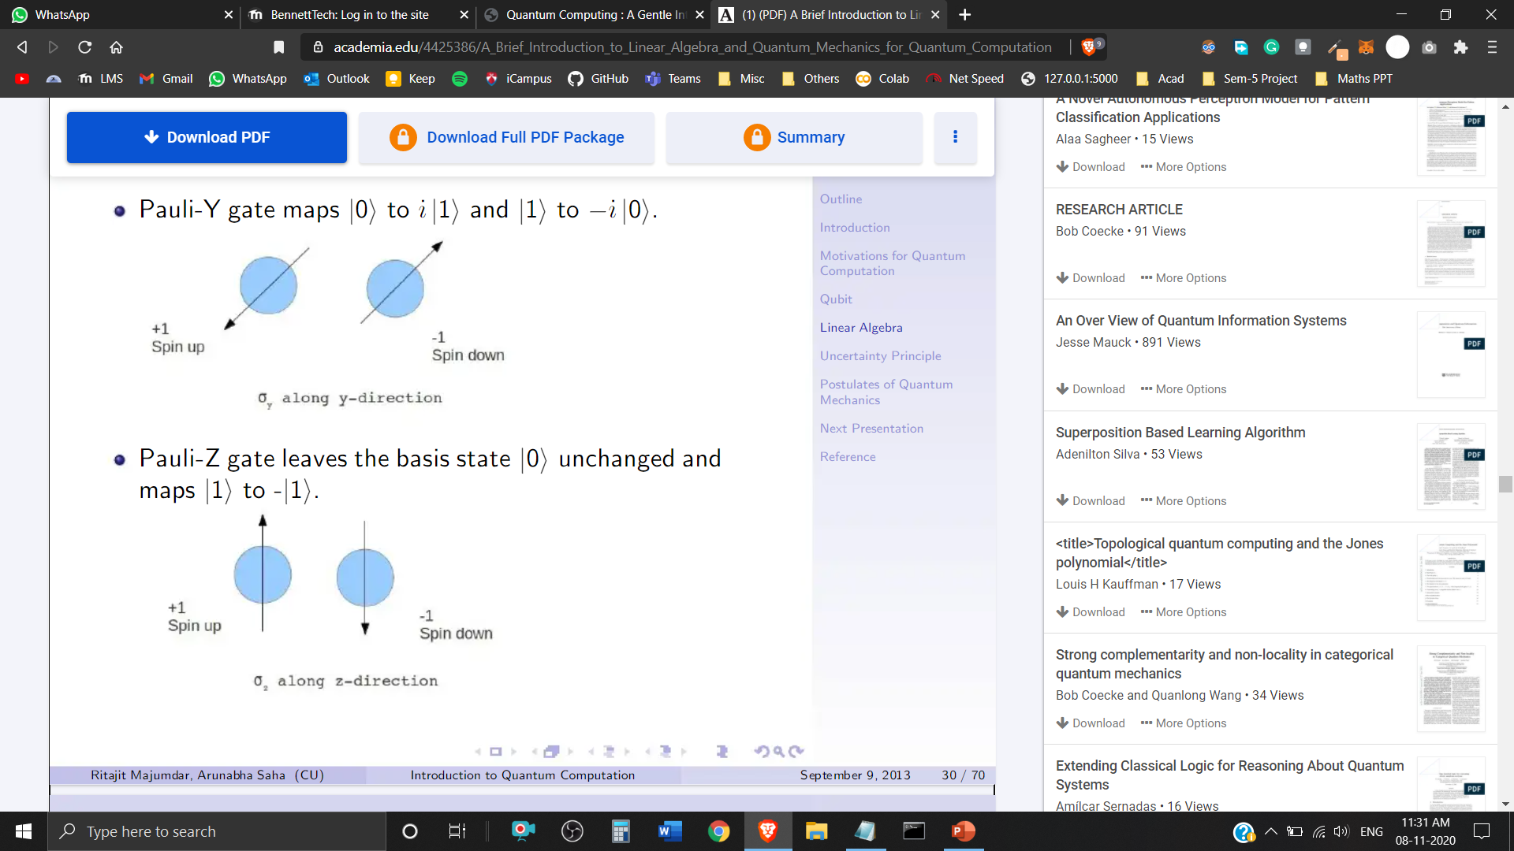
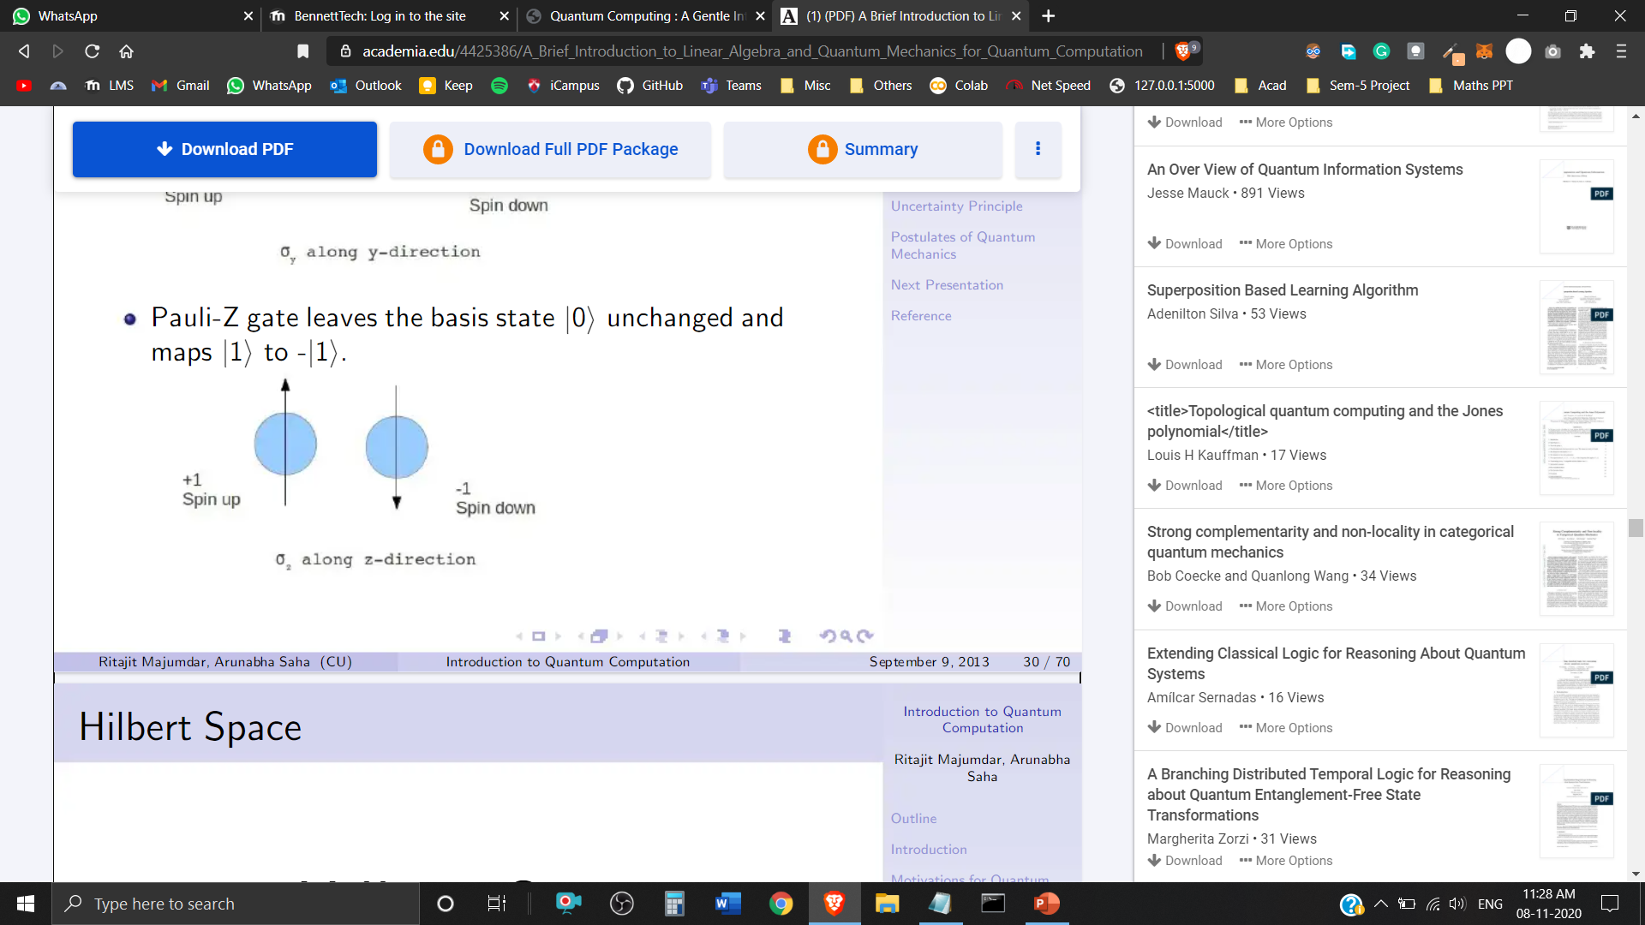
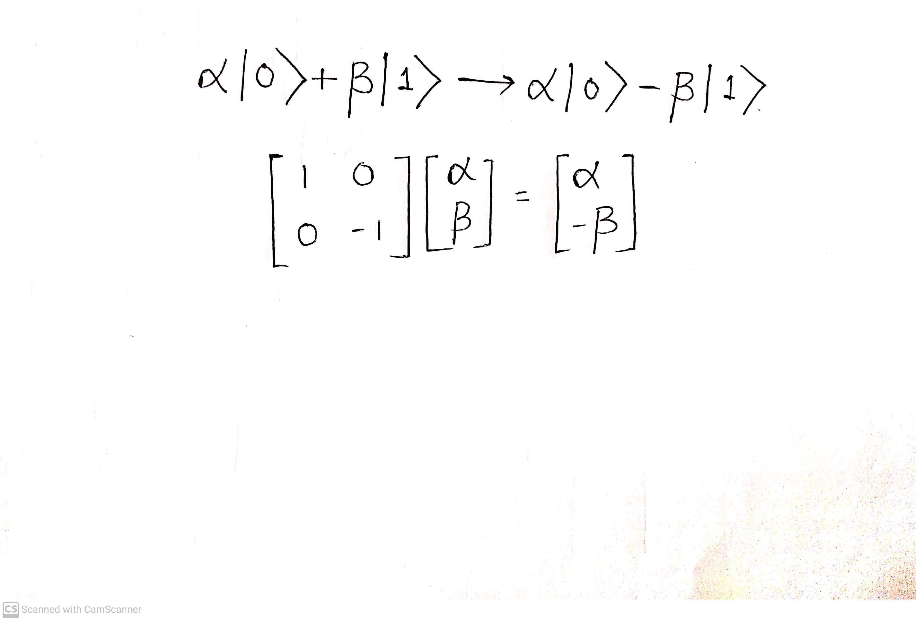
Pauli Transformations
The Pauli-X gate is the quantum equivalent of NOT gate. It maps
The Pauli-Y gate maps
The Pauli-Z gate leaves the basis state unchanged and maps

Slide 30

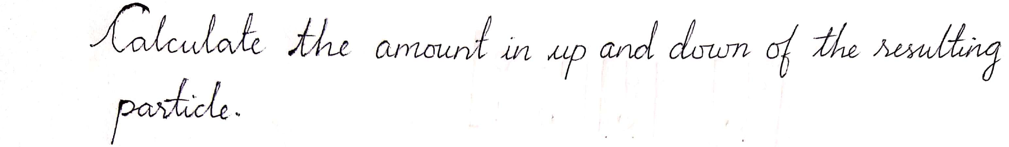
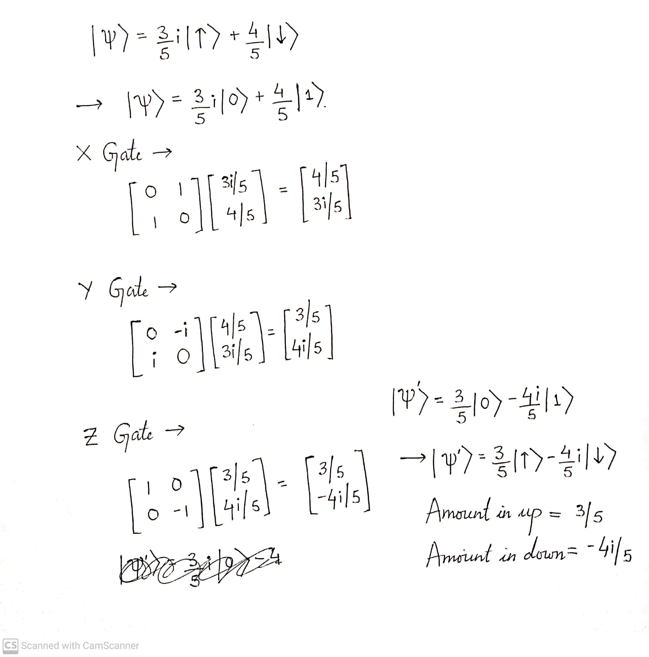

Slide 31

Bloch Sphere
In quantum mechanics and computing, the Bloch sphere is a geometrical representation of the pure state space of a two-level quantum mechanical system (qubit), named after the physicist Felix Bloch.

Slide 32

Rotation Operators on Bloch Sphere
When the Pauli X, Y and Z matrices are exponentiated, they give rise to the rotation operators, which rotate the Bloch vector of the Quantum State about the ˆx, ˆy and ˆz axes, by a given angle θ:

Slide 33






Slide 34
Quantum Entanglement
The term ‘Entanglement’ means that the two members of a pair exist in a single quantum state.
Changing the state of one of the qubits will instantaneously change the state of the other one in a predictable fashion.
This property is used as a resource in Quantum Computing such as
○ Super dense coding
○ Quantum Teleportation
○ Error Correction

Slide 35



Slide 36
Hilbert Space
‘Wave functions live in the Hilbert Space.’
Hilbert space which contains the "wavefunctions" that stand for the possible states of the system.
Absolute value of each wave function is interpreted as being a probability distribution function.

Slide 37

Hilbert Space
The Mathematical Concept of Hilbert Space has been named after David Hilbert.
Hilbert Space is an abstract vector space with inner product defined in it, that allow the length and angle to be measured.
Hilbert Space must be complete.
It is an Infinite Dimensional Inner Product Space
A Hilbert Space H of d = 3 is referred to as a Qutrit, d = 4 is sometimes called a Ququart, and the generic term for any d > 2 is Qudit.

Slide 38

Unitary Transformation

Slide 39

Observables
A system ‘Observable’ is a measurable operator, where the property of the system state can be determined by some sequence of physical operations.
In Quantum Mechanics, each ‘Dimensional Variable’ – Position, Translational Momentum, Orbital Angular Momentum, Energy, Spin, etc. is associated with a Hermitian Operator that acts on the state of the quantum system, whose Eigenvalues correspond to the possible values of the dynamical variable.
Let be an Eigenvector of the Observable ‘A’ with Eigenvalue a, and exists in a D-Dimensional Hilbert Space, then
This equation states that if a measurement of the Observable A is made while the system is in Quantum State, then the observed value of that measurement must return the eigenvalue a with certainty.

Slide 40

Hermitian Operator
Self-Adjoint Operator
Hermitian Matrix is a square matrix with complex entries that is equal to its own conjugate transpose.
or
Eigenvalues of Hermitian operators are real.
Any function (in Hilbert space) can be expressed as the linear combination of them.

Slide 41

1st Postulate: State Space
of Quantum Mechanics
Associated to any isolated system is a Hilbert Space called the state space. The system is completely defined by the state vector, which is a unit vector in the state space.

Slide 42

2nd Postulate: Evolution
of Quantum Mechanics
The evolution of a closed Quantum System is described by a Unitary Transformation.

Slide 43
References
N. David Mermin, Cornell University Lecture Notes on Quantum Computation
http://www.wikipedia.org
https://www.academia.edu/4425386/A_Brief_Introduction_to_Linear_Algebra_and_Quantum_Mechanics_for_Quantum_Computation
https://cse.iitkgp.ac.in/~goutam/quantumComputing/lect4part.pdf
David J. Griffiths Introduction to Quantum Mechanics
https://qudev.phys.ethz.ch/static/content/courses/QSIT08/QSIT08_V03_2page.pdf

Slide 44
Thank You!
A Presentation by – Tanvi Penumudy
(E18CSE187)

